Slide 1

Simplifying Surds
Bingo Game

Slide 2
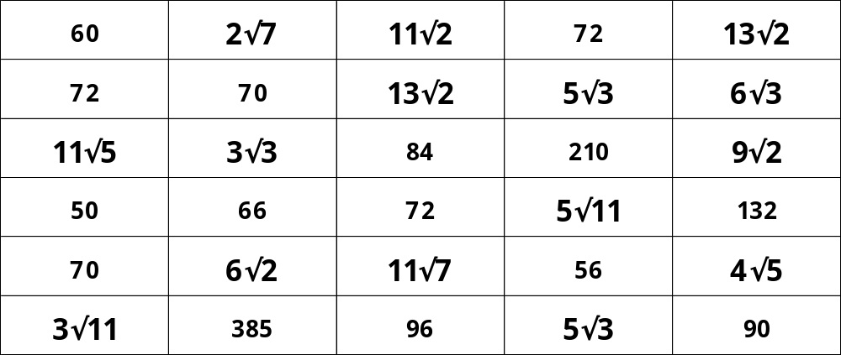
Pick 9 answers from the grid below

Slide 3
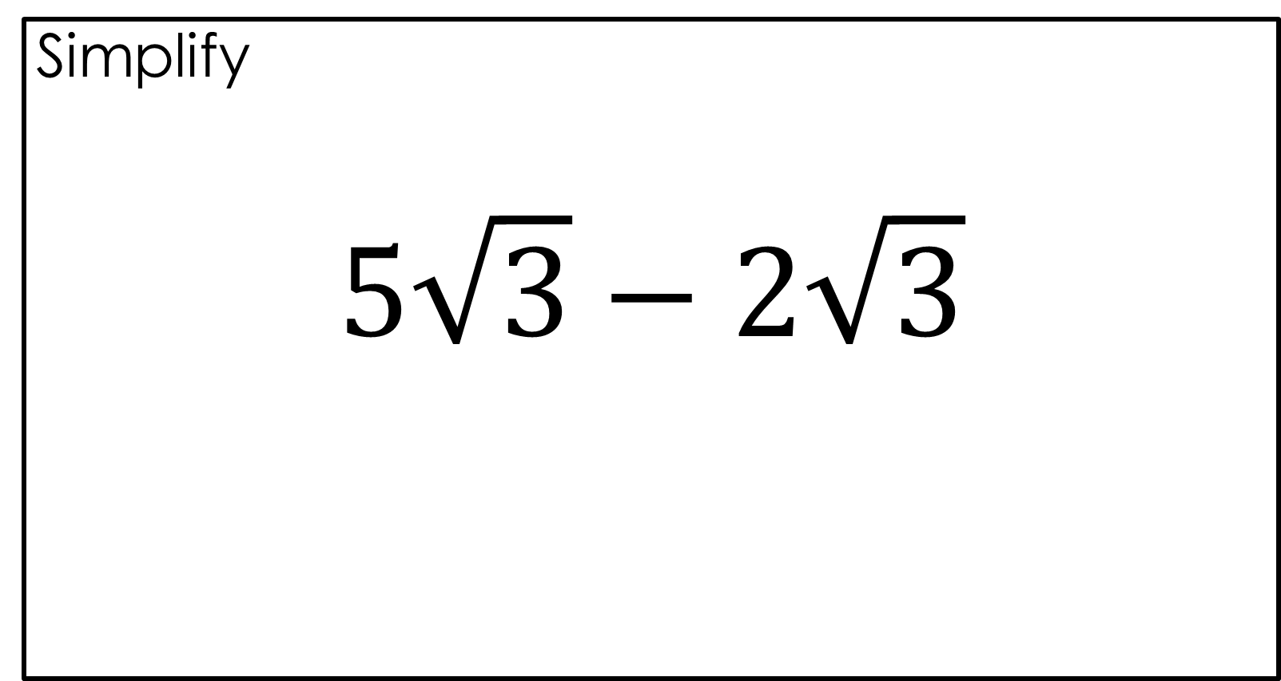
Simplify
$$5\sqrt{3}−2\sqrt{3}$$

Slide 4

Simplify
$$5\sqrt{3}−2\sqrt{3}$$
$$3\sqrt{3}$$

Slide 5
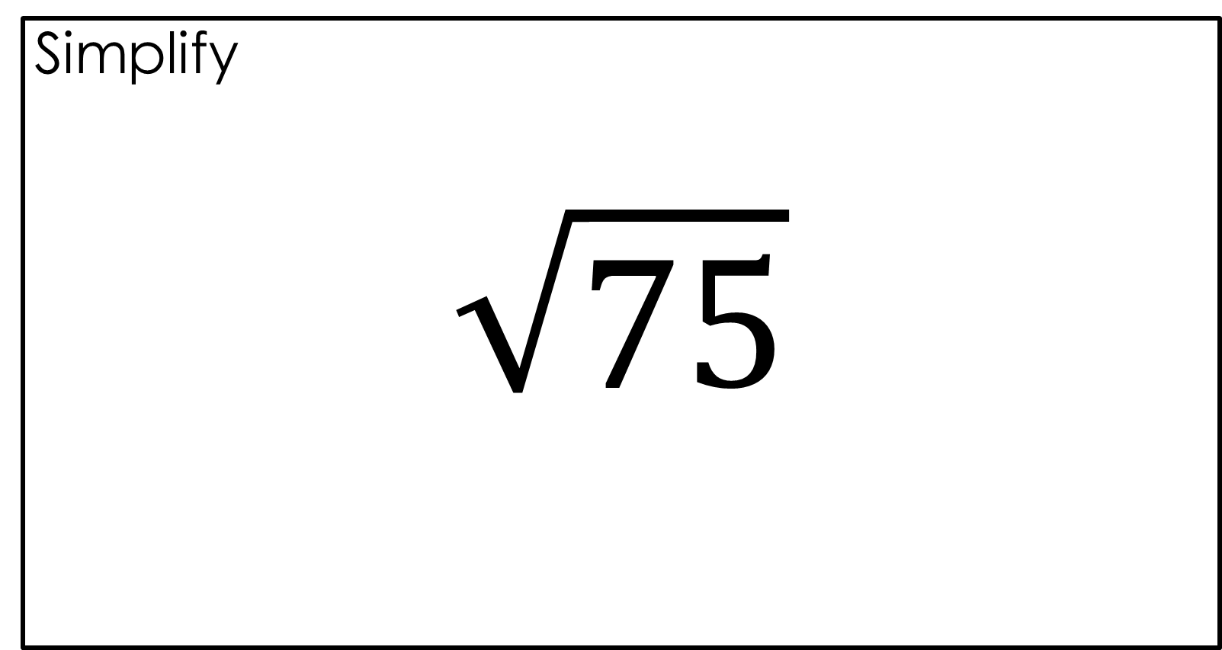
Simplify
$$\sqrt{75}$$

Slide 6

Simplify
$$\sqrt{75}$$
$$5\sqrt{3}$$

Slide 7
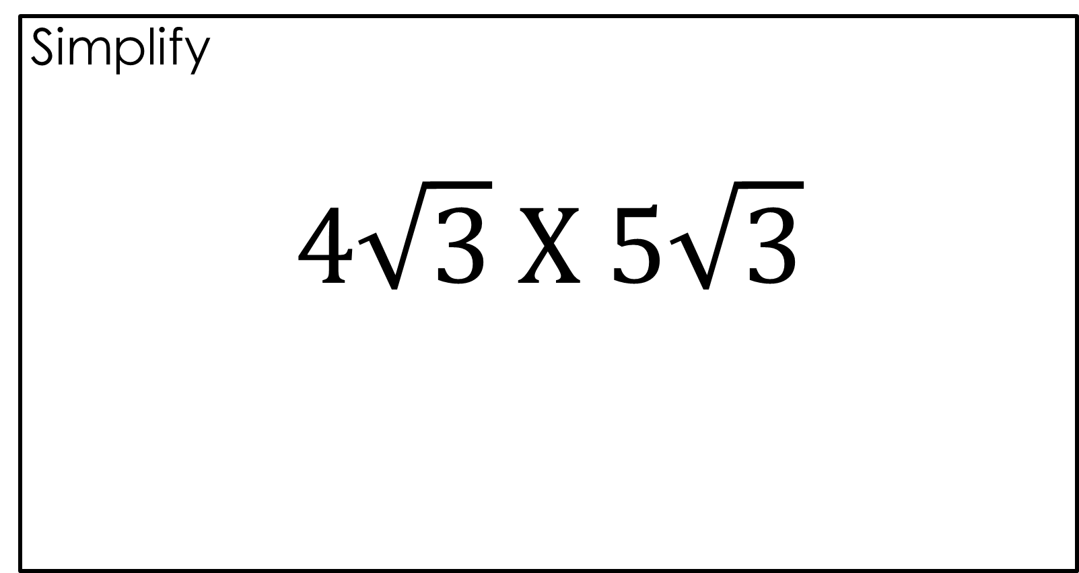
Simplify
$$4\sqrt{3} X 5\sqrt{3}$$

Slide 8

Simplify
$$4\sqrt{3} X 5\sqrt{3}$$
$$60$$

Slide 9
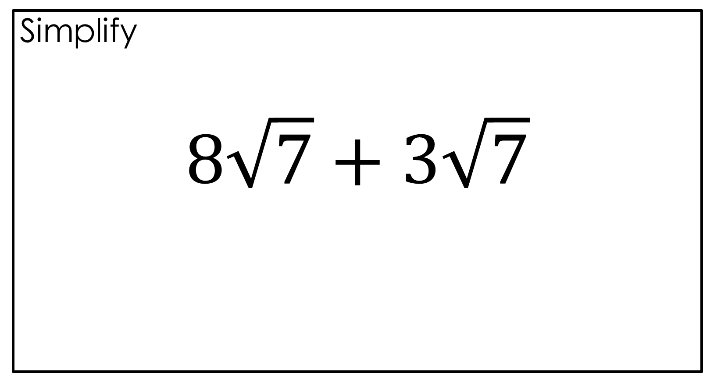
Simplify
$$8\sqrt{7}+3\sqrt{7}$$

Slide 10

Simplify
$$8\sqrt{7}+3\sqrt{7}$$
$$11\sqrt{7}$$

Slide 11
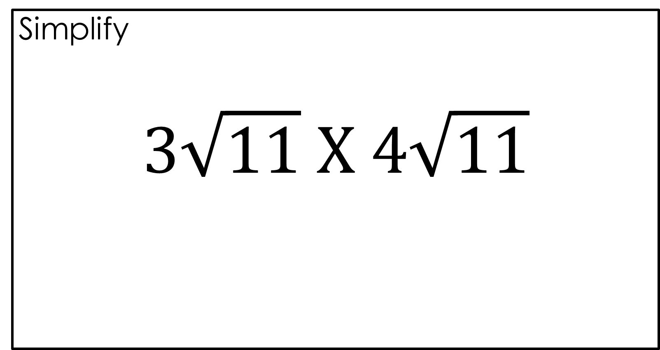
Simplify
$$3\sqrt{11} X 4\sqrt{11}$$

Slide 12

Simplify
$$3\sqrt{11} X 4\sqrt{11}$$
$$132$$

Slide 13
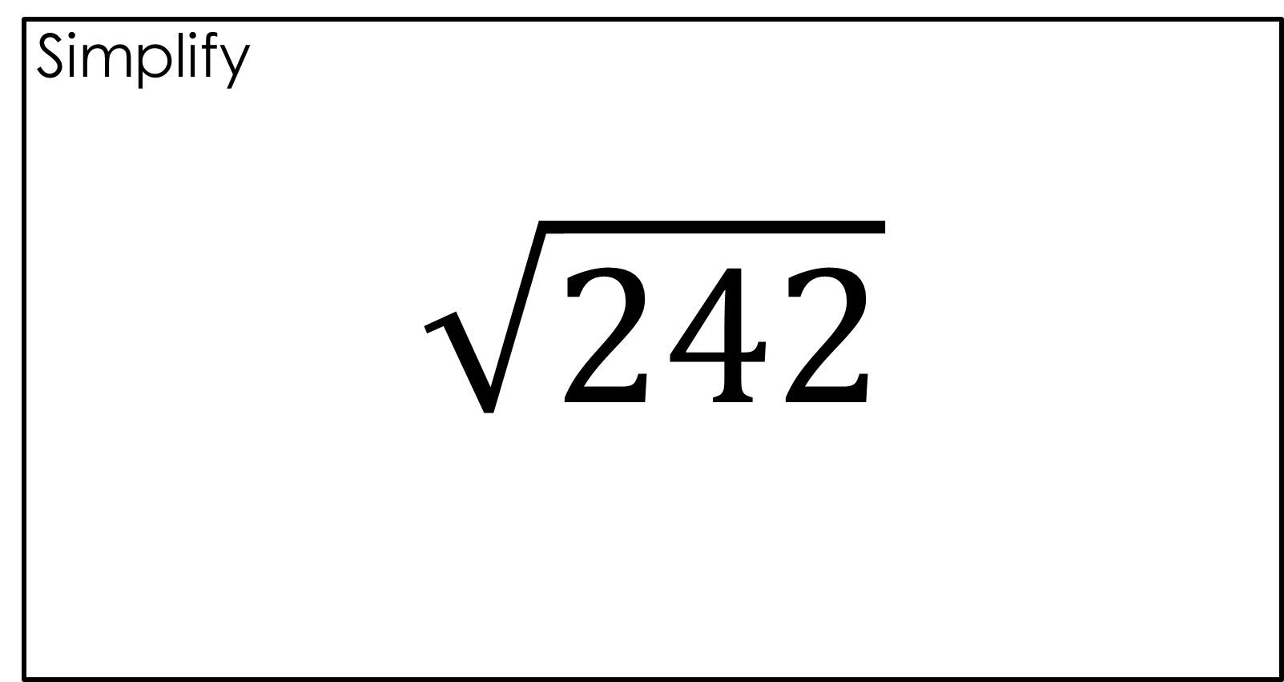
Simplify
$$\sqrt{242}$$

Slide 14

Simplify
$$\sqrt{242}$$
$$11\sqrt{2}$$

Slide 15
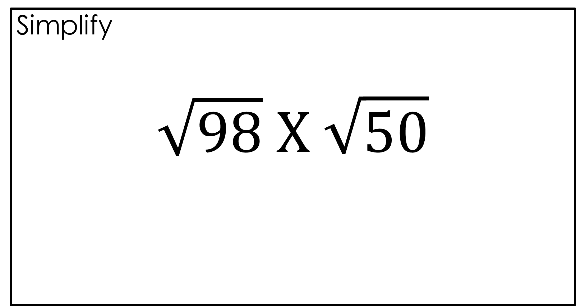
Simplify
$$\sqrt{98} X \sqrt{50}$$

Slide 16

Simplify
$$\sqrt{98} X \sqrt{50}$$
$$70$$

Slide 17
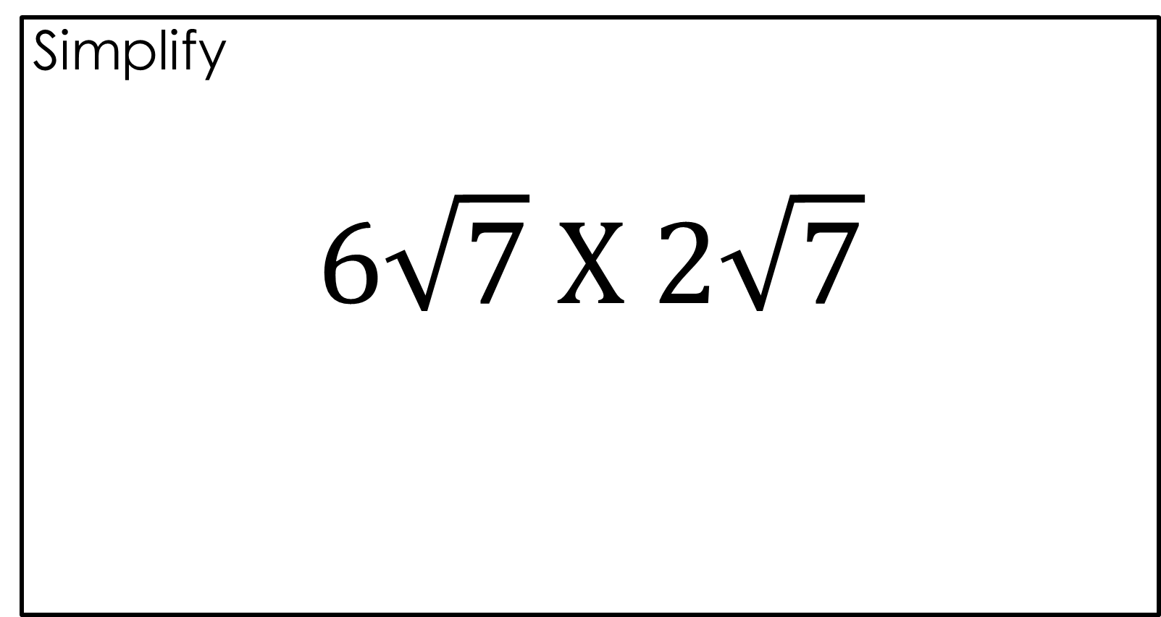
Simplify
$$6\sqrt{7} X 2\sqrt{7}$$

Slide 18

Simplify
$$6\sqrt{7} X 2\sqrt{7}$$
$$84$$

Slide 19
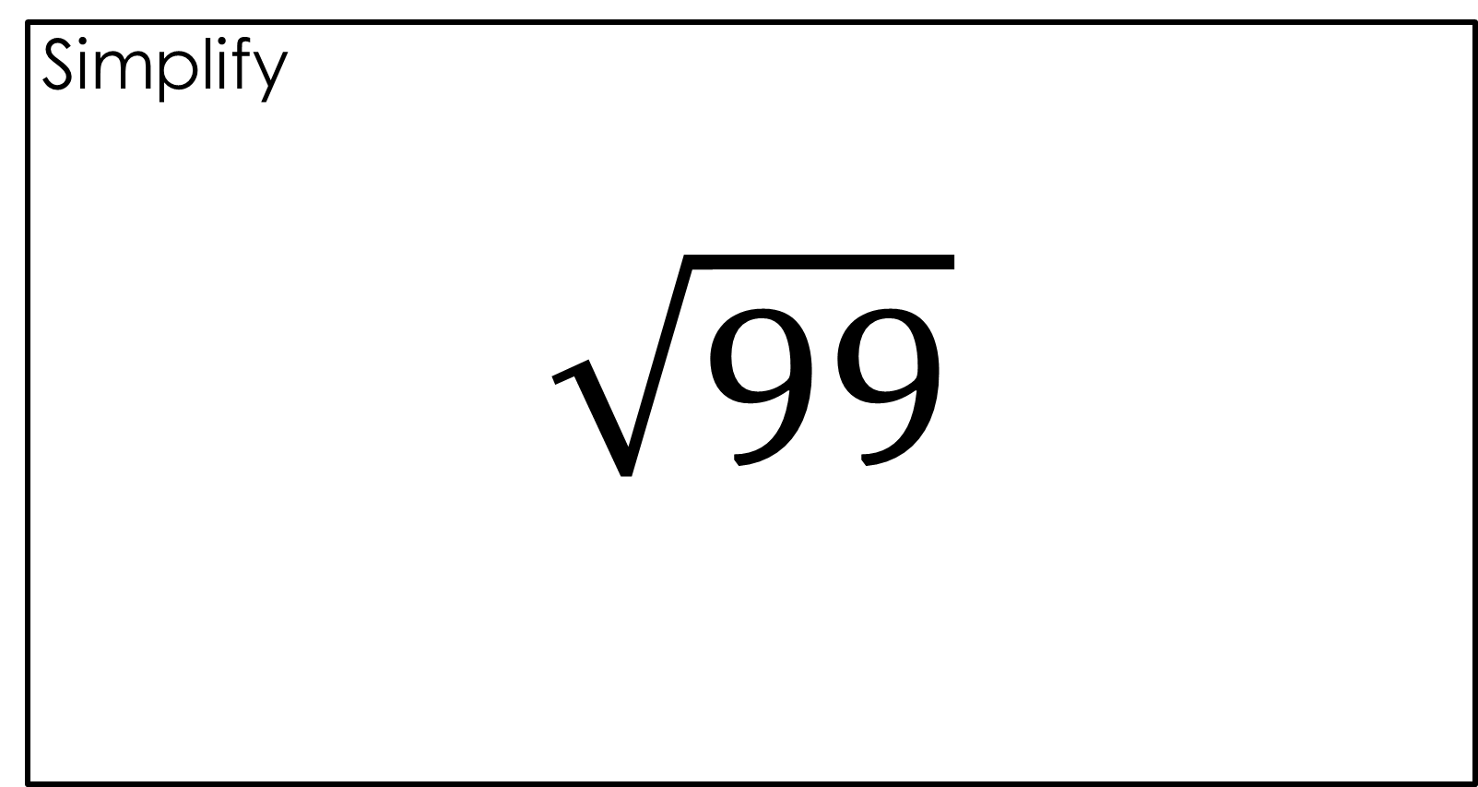
Simplify
$$\sqrt{99}$$

Slide 20

Simplify
$$\sqrt{99}$$
$$3\sqrt{11}$$

Slide 21
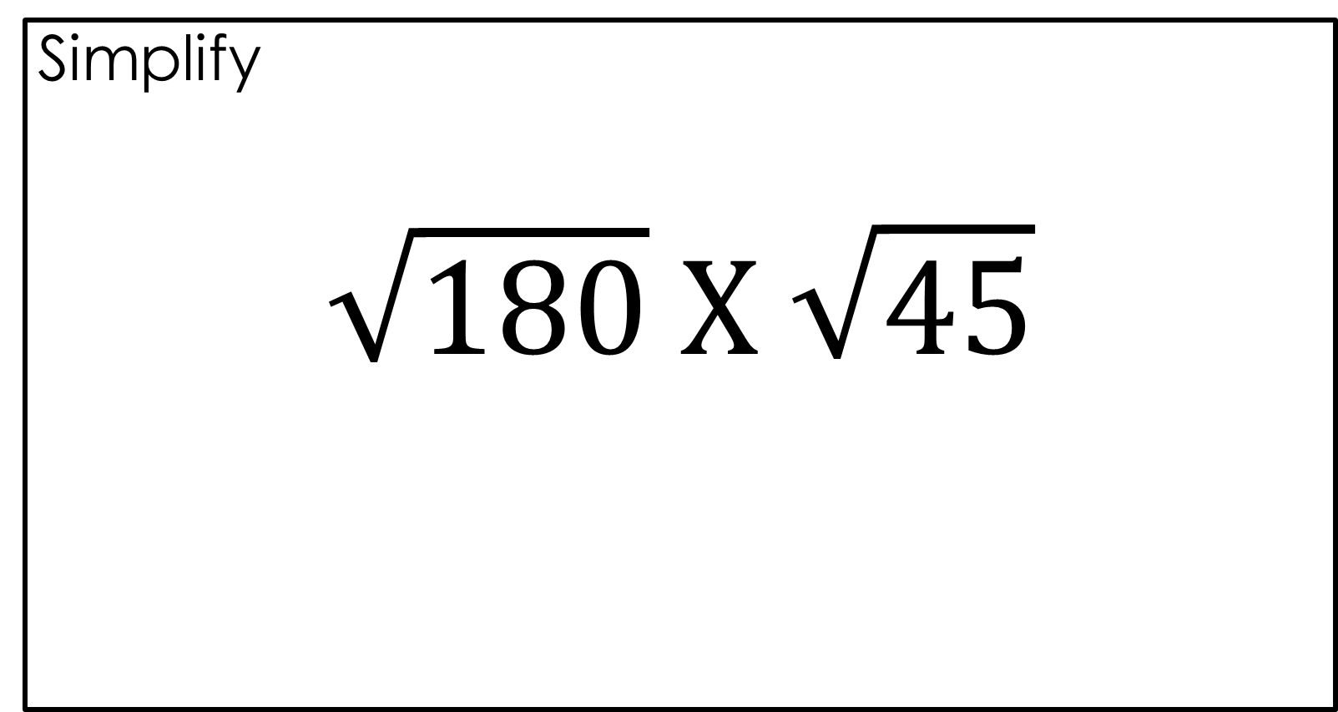
Simplify
$$\sqrt{180} X \sqrt{45}$$

Slide 22

Simplify
$$\sqrt{180} X \sqrt{45}$$
$$90$$

Slide 23
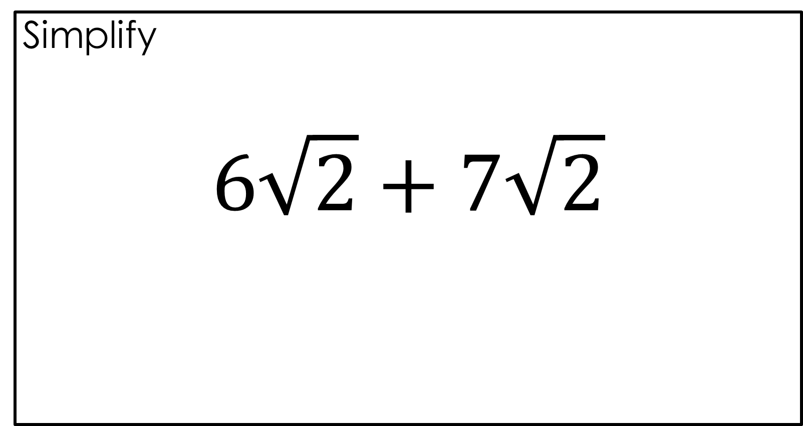
Simplify
$$6\sqrt{2}+7\sqrt{2}$$

Slide 24

Simplify
$$6\sqrt{2}+7\sqrt{2}$$
$$13\sqrt{2}$$

Slide 25
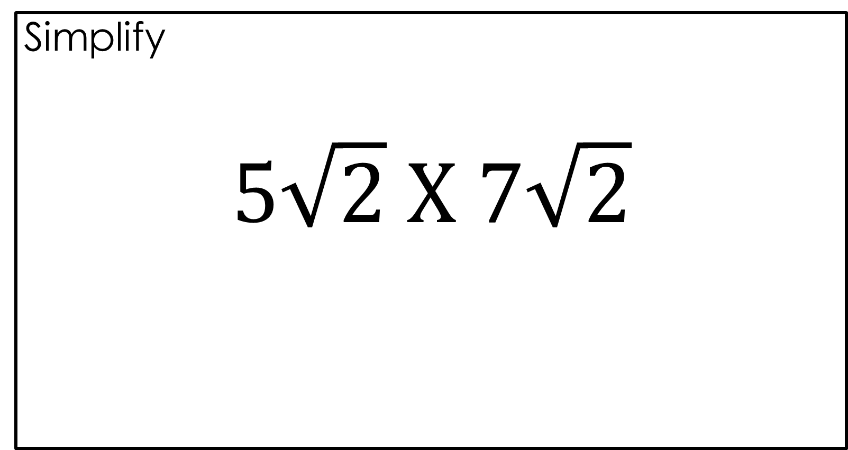
Simplify
$$5\sqrt{2} X 7\sqrt{2}$$

Slide 26
Simplify
$$5\sqrt{2} X 7\sqrt{2}$$
$$70$$

Slide 27
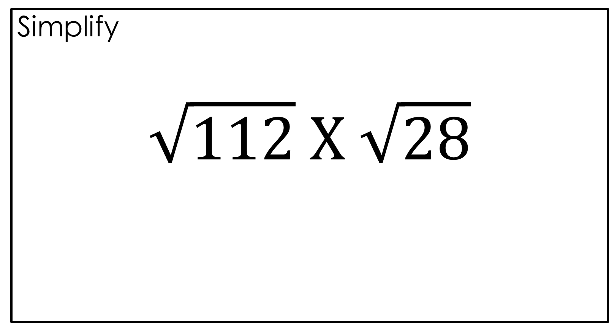
Simplify
$$\sqrt{112} X \sqrt{28}$$

Slide 28

Simplify
$$\sqrt{112} X \sqrt{28}$$
$$56$$

Slide 29
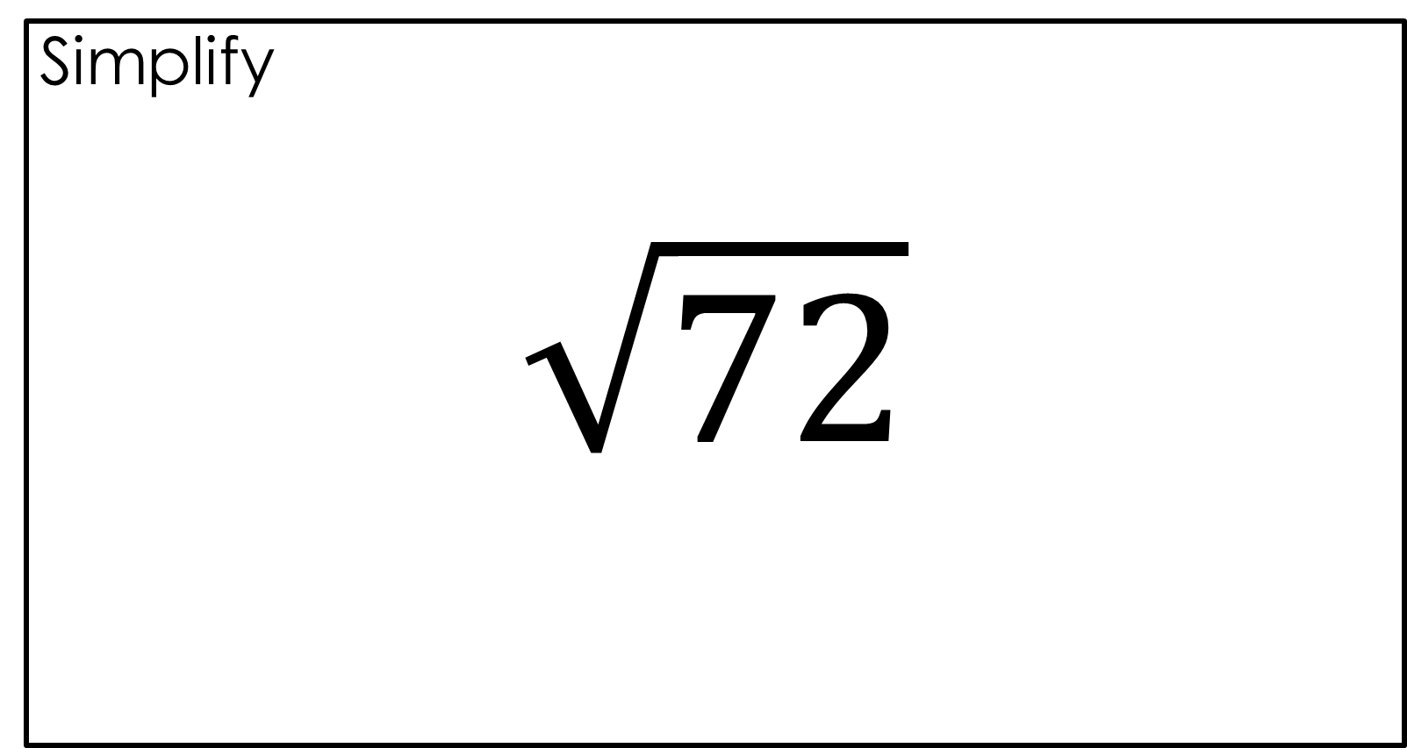
Simplify
$$\sqrt{72}$$

Slide 30

Simplify
$$\sqrt{72}$$
$$6\sqrt{2}$$

Slide 31
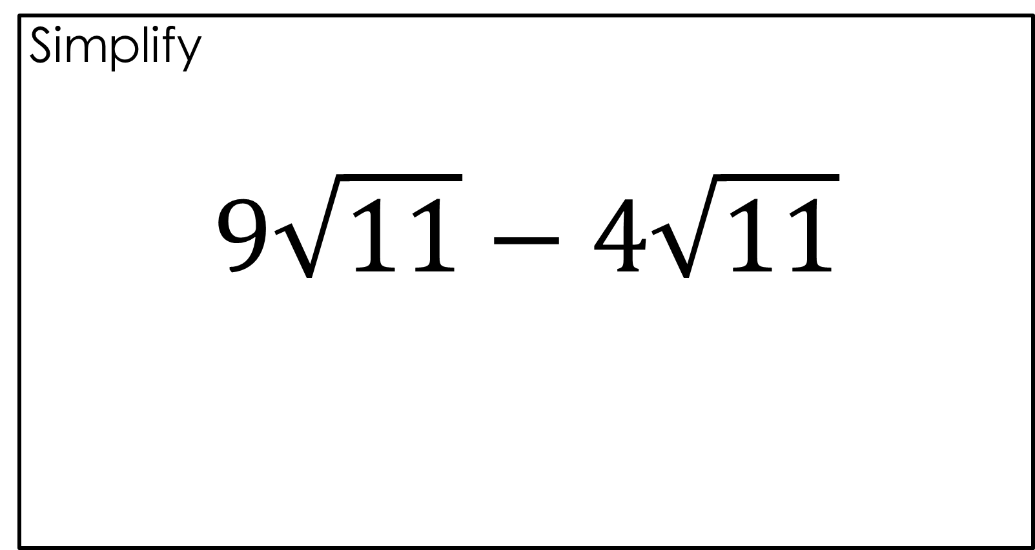
Simplify
$$9\sqrt{11}−4\sqrt{11}$$

Slide 32

Simplify
$$9\sqrt{11}−4\sqrt{11}$$
$$5\sqrt{11}$$

Slide 33
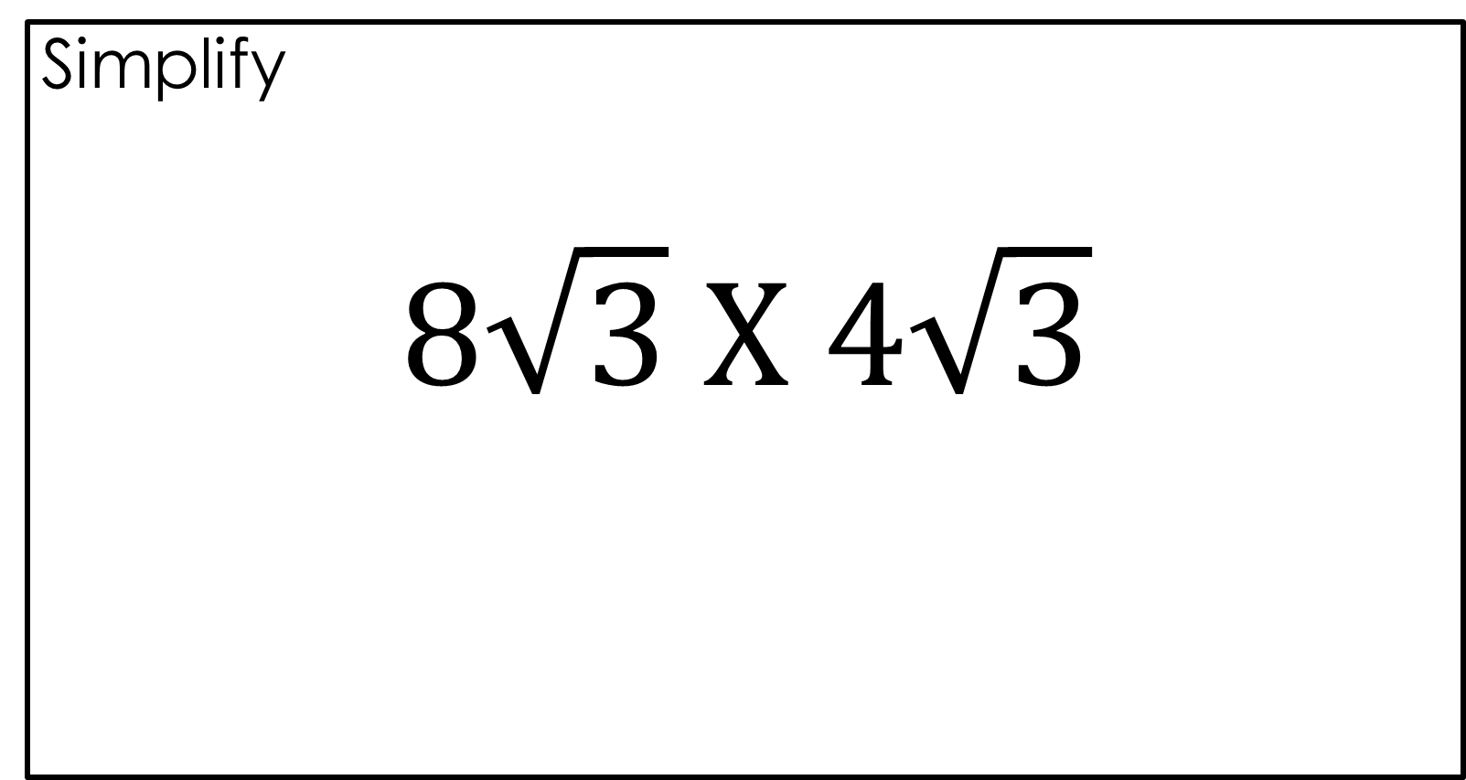
Simplify
$$8\sqrt{3} X 4\sqrt{3}$$

Slide 34

Simplify
$$8\sqrt{3} X 4\sqrt{3}$$
$$96$$

Slide 35
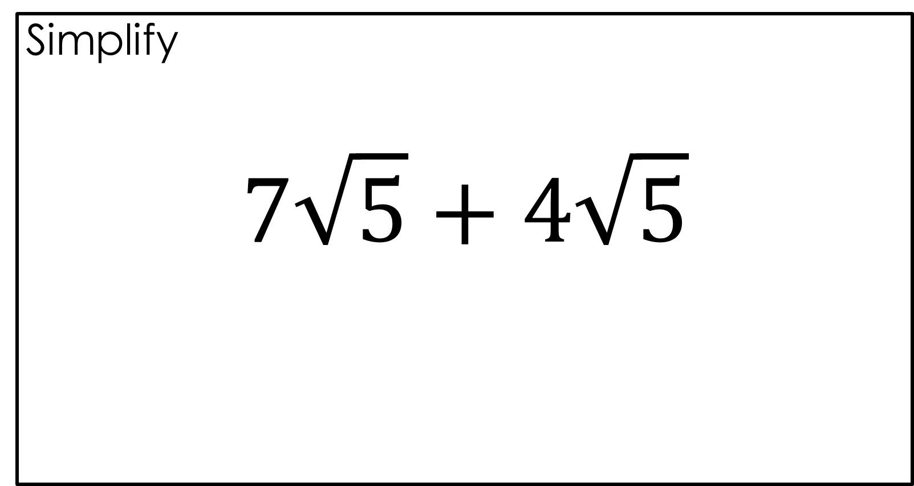
Simplify
$$7\sqrt{5}+4\sqrt{5}$$

Slide 36

Simplify
$$7\sqrt{5}+4\sqrt{5}$$
$$11\sqrt{5}$$

Slide 37
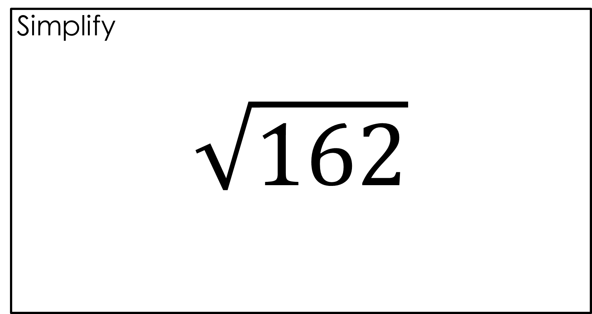
Simplify
$$\sqrt{162}$$

Slide 38

Simplify
$$\sqrt{162}$$
$$9\sqrt{2}$$

Slide 39
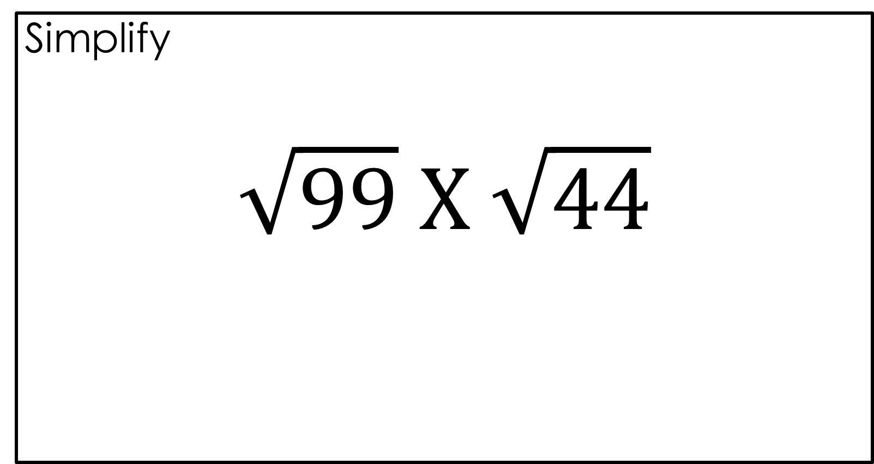
Simplify
$$\sqrt{99} X \sqrt{44}$$

Slide 40

Simplify
$$\sqrt{99} X \sqrt{44}$$
$$66$$

Slide 41
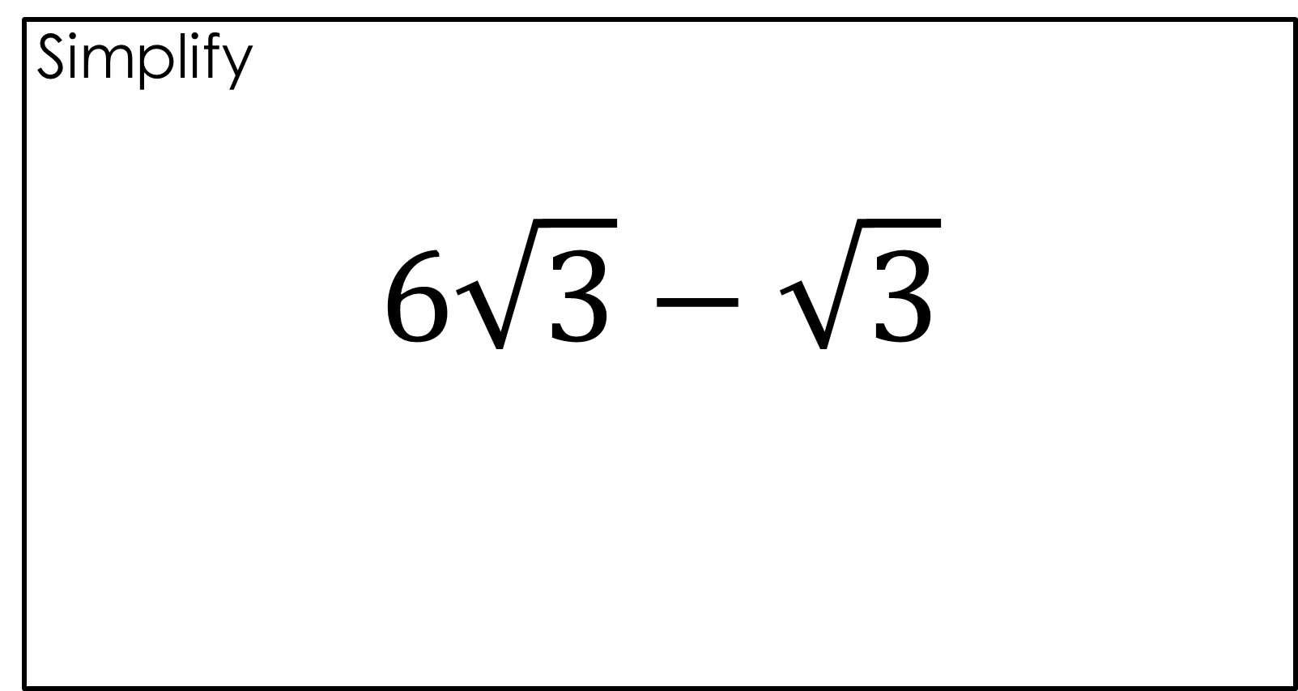
Simplify
$$6\sqrt{3}−\sqrt{3}$$

Slide 42
Simplify
$$6\sqrt{3}−\sqrt{3}$$
$$5\sqrt{3}$$

Slide 43
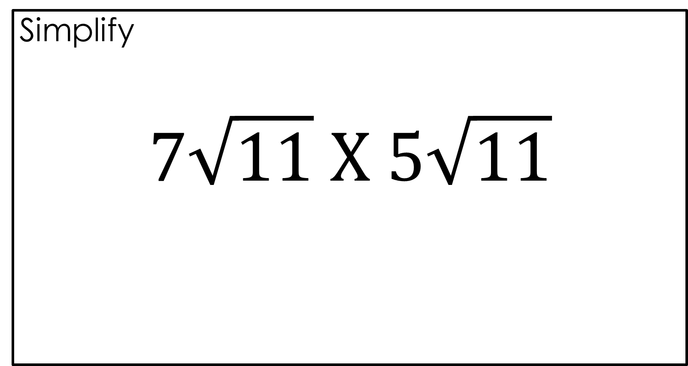
Simplify
$$7\sqrt{11} X 5\sqrt{11}$$

Slide 44

Simplify
$$7\sqrt{11} X 5\sqrt{11}$$
$$385$$

Slide 45
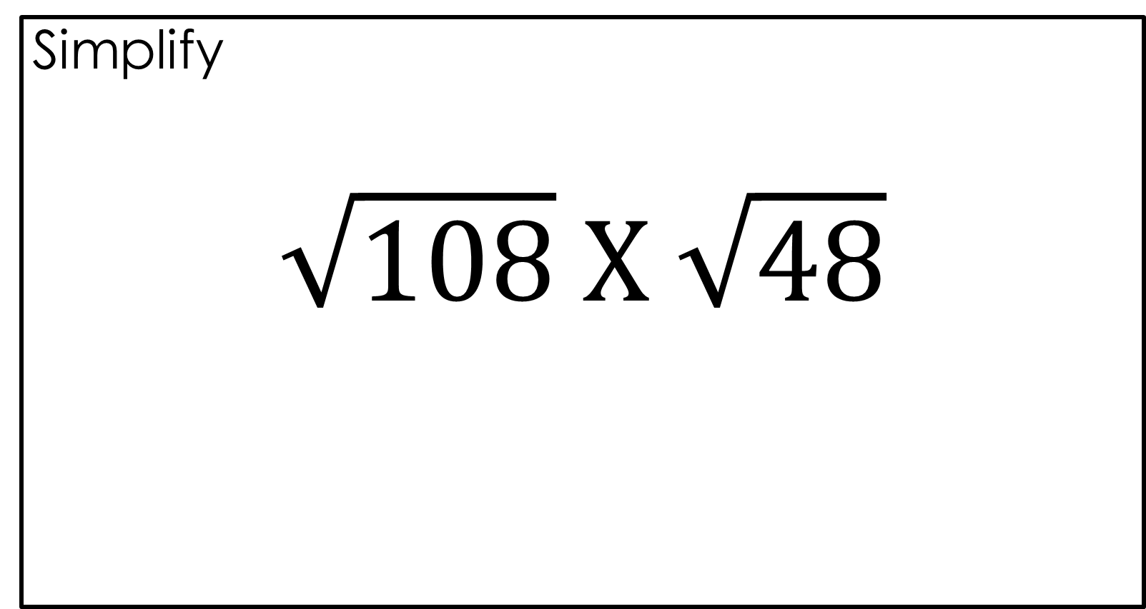
Simplify
$$\sqrt{108} X \sqrt{48}$$

Slide 46

Simplify
$$\sqrt{108} X \sqrt{48}$$
$$72$$

Slide 47
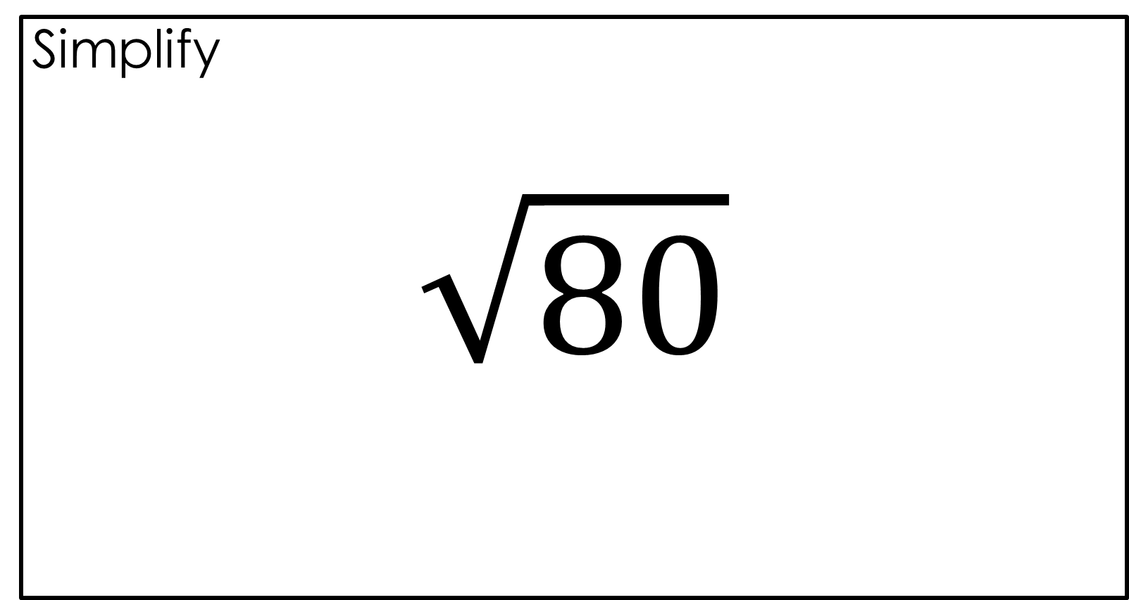
Simplify
$$\sqrt{80}$$

Slide 48

Simplify
$$\sqrt{80}$$
$$4\sqrt{5}$$

Slide 49
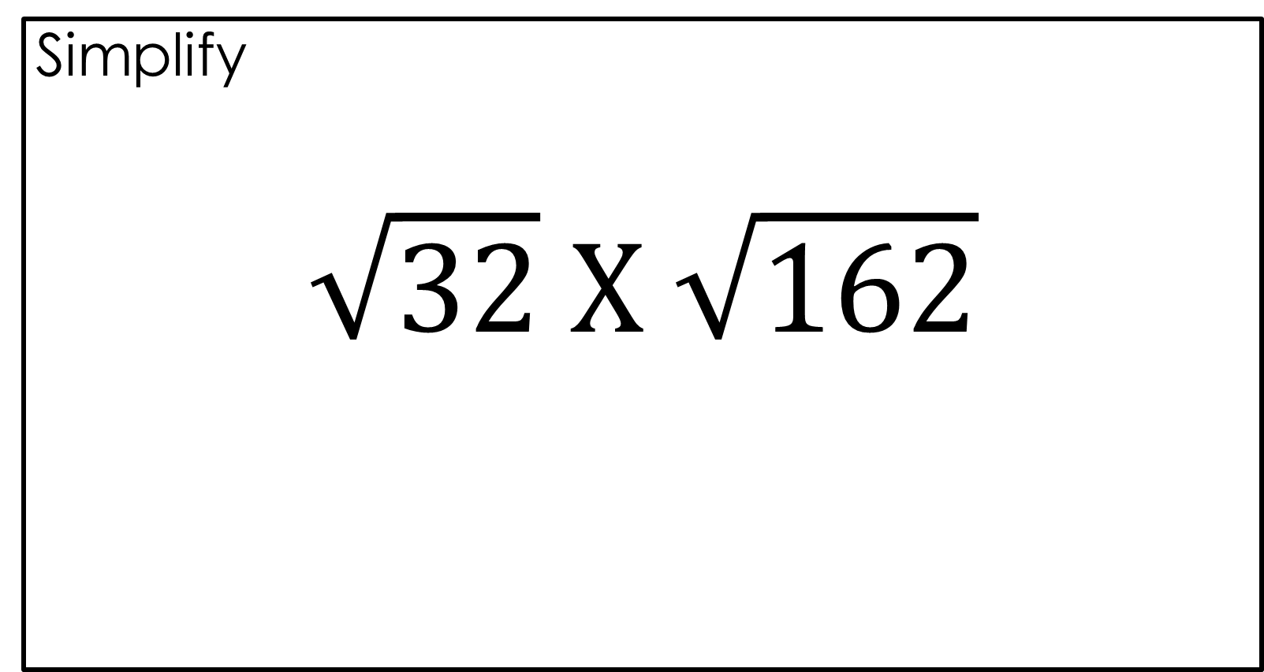
Simplify
$$\sqrt{32} X \sqrt{162}$$

Slide 50
Simplify
$$\sqrt{32} X \sqrt{162}$$
$$72$$

Slide 51
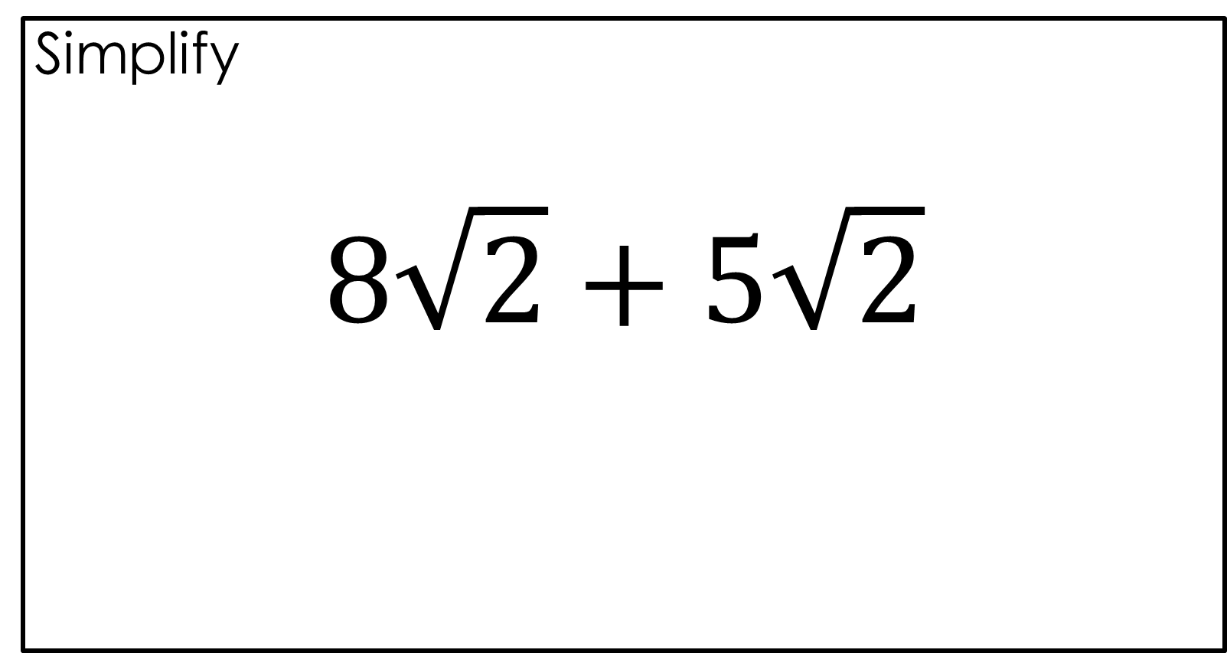
Simplify
$$8\sqrt{2}+5\sqrt{2}$$

Slide 52
Simplify
$$8\sqrt{2}+5\sqrt{2}$$
$$13\sqrt{2}$$

Slide 53
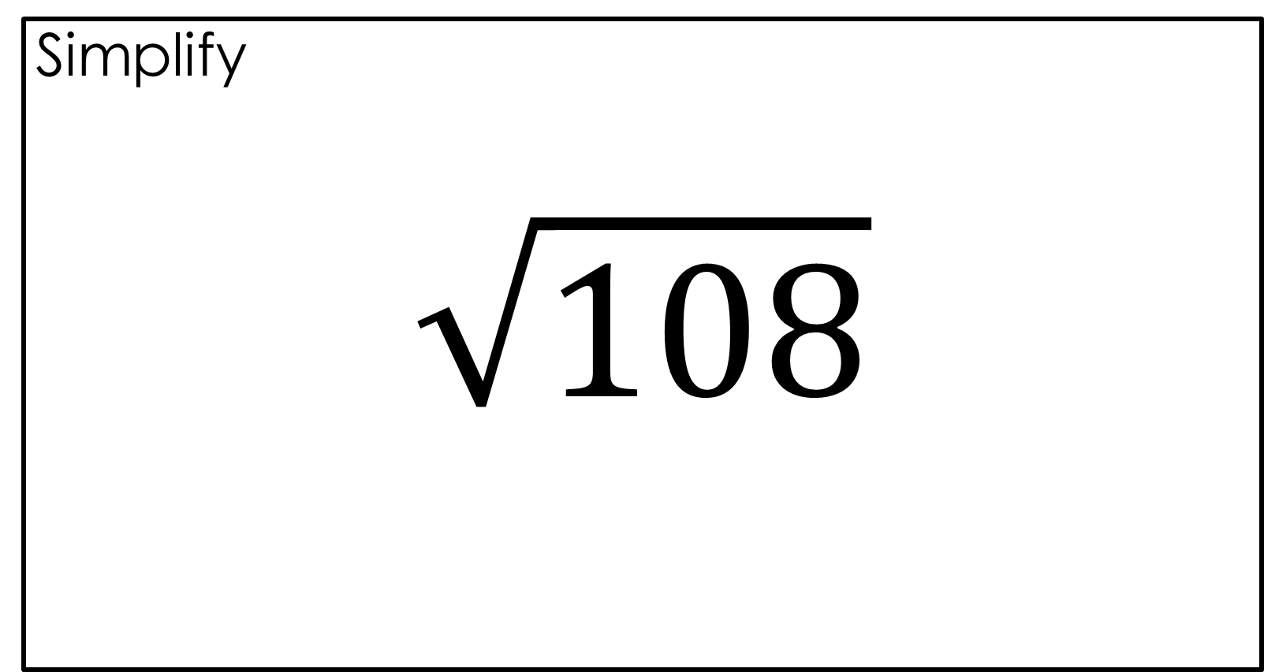
Simplify
$$\sqrt{108}$$

Slide 54

Simplify
$$\sqrt{108}$$
$$6\sqrt{3}$$

Slide 55

Simplify
$$8\sqrt{3} X 3\sqrt{3}$$

Slide 56
Simplify
$$8\sqrt{3} X 3\sqrt{3}$$
$$72$$

Slide 57
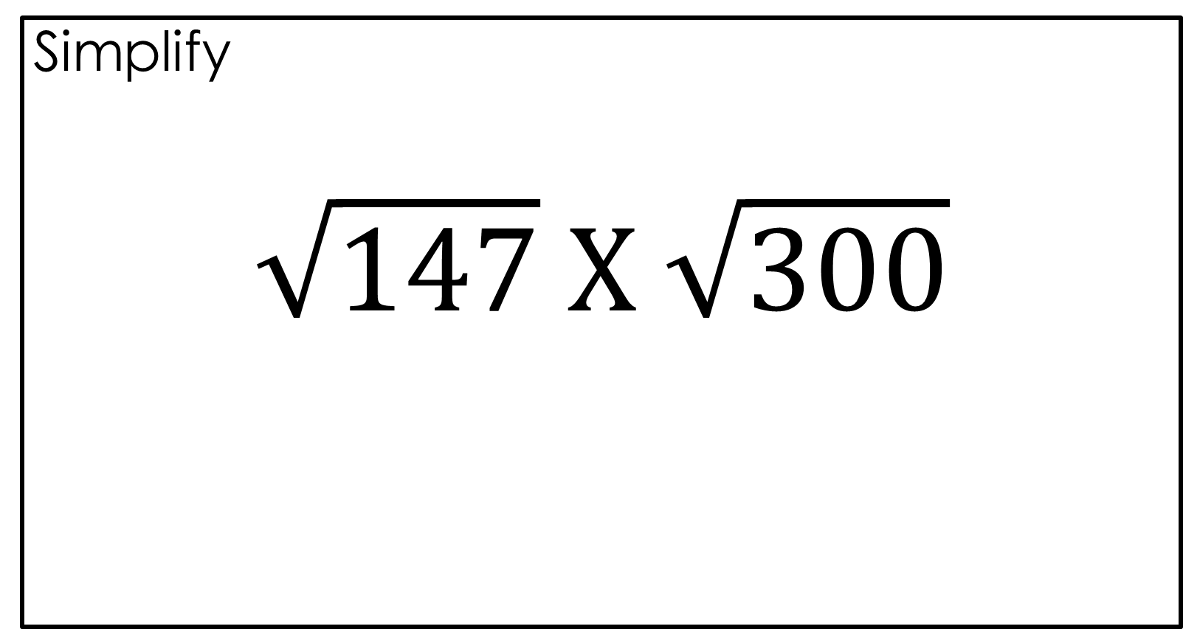
Simplify
$$\sqrt{147} X \sqrt{300}$$

Slide 58

Simplify
$$\sqrt{147} X \sqrt{300}$$
$$210$$

Slide 59

Simplify
$$\sqrt{28}$$

Slide 60

Simplify
$$\sqrt{28}$$
$$2\sqrt{7}$$

Slide 61
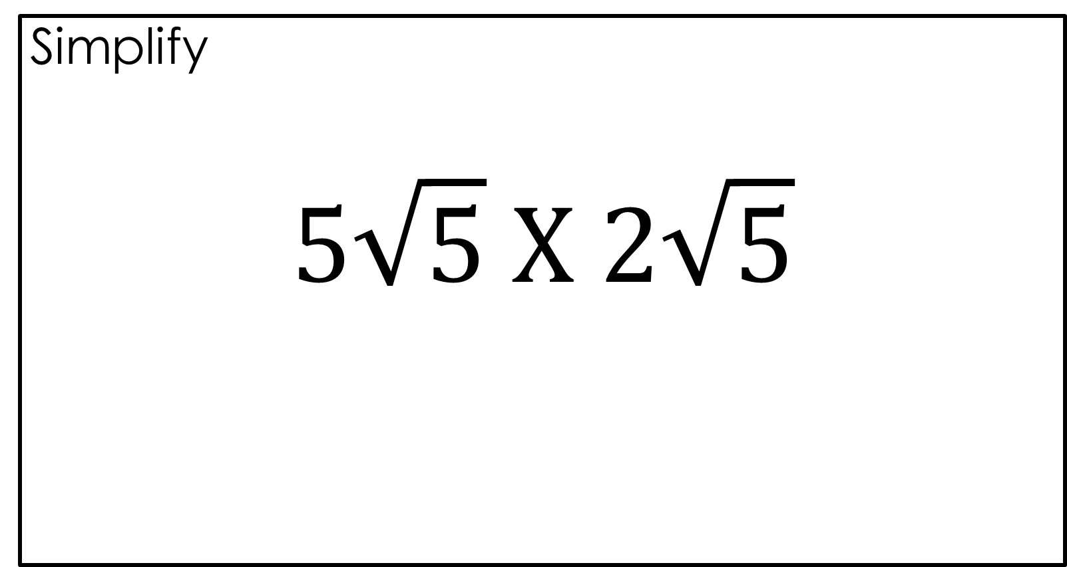
Simplify
$$5\sqrt{5} X 2\sqrt{5}$$

Slide 62

Simplify
$$5\sqrt{5} X 2\sqrt{5}$$
$$50$$

