Slide 1
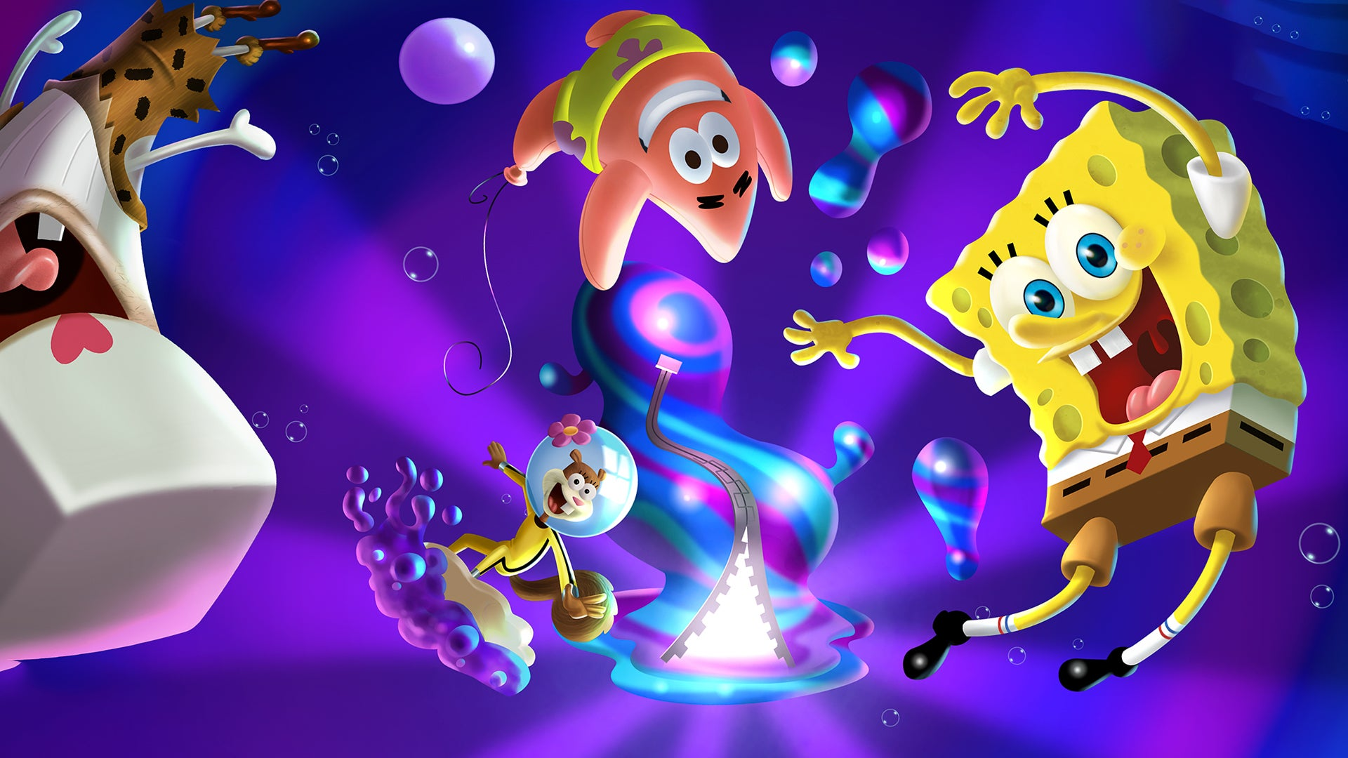


Slide 2

Welcome to Spongebob Bomb Game
Welcome to Spongebob Bomb Game
You will be put into 2 groups
Each group must pick a letter. Each letter contains a question. If you answer that question correct, you will receive a surprise. Be careful. The surprise could be reward or a punishment.
To return to the home page, click the SpongeBob logo

Slide 3
A
B
C
D
E
F
G
H
J
K
L
M
I
Q
R
S
T
N
O
P
U
V
W
X
Y
Z

Slide 4
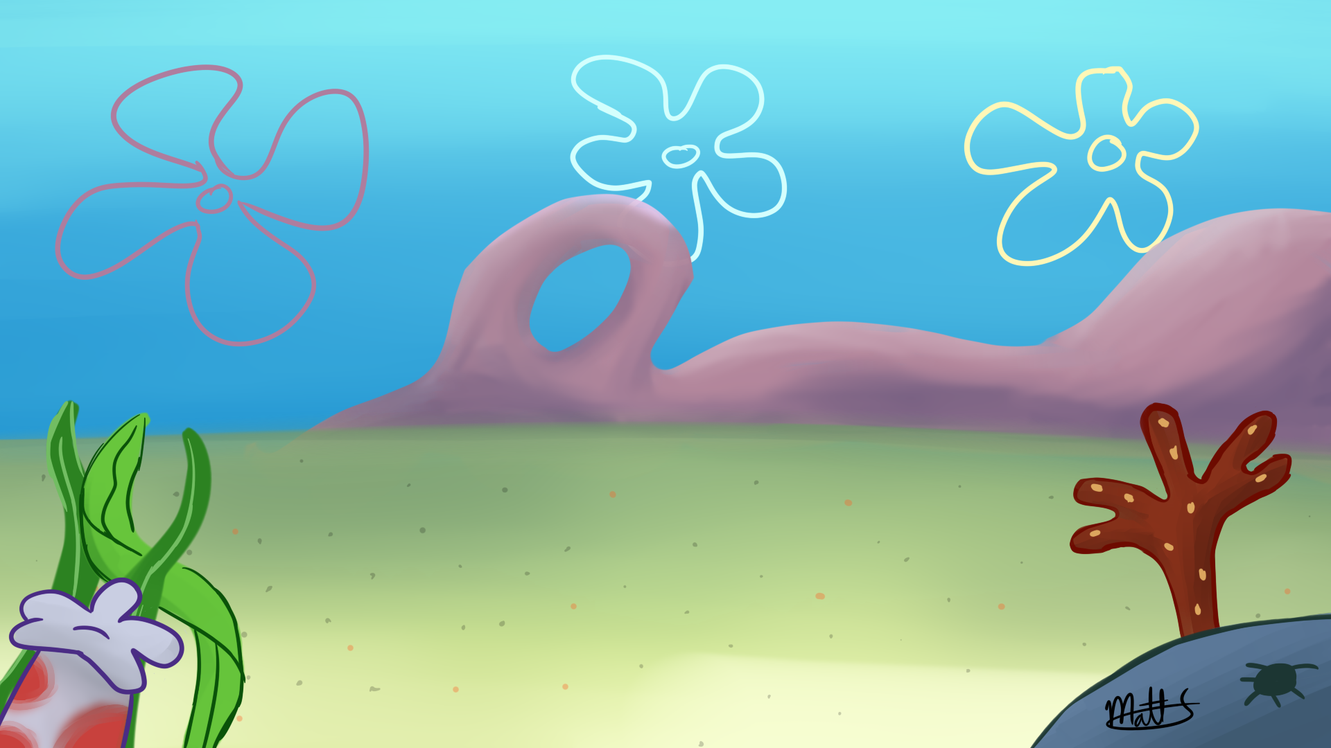
What does “difficult” mean?
Not easy, very hard
Press the space bar to reveal prize

Slide 5



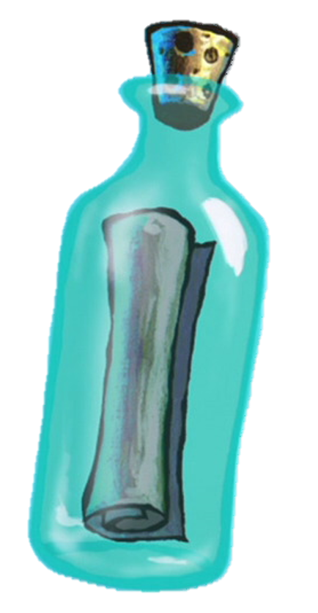

Pick one

Slide 6
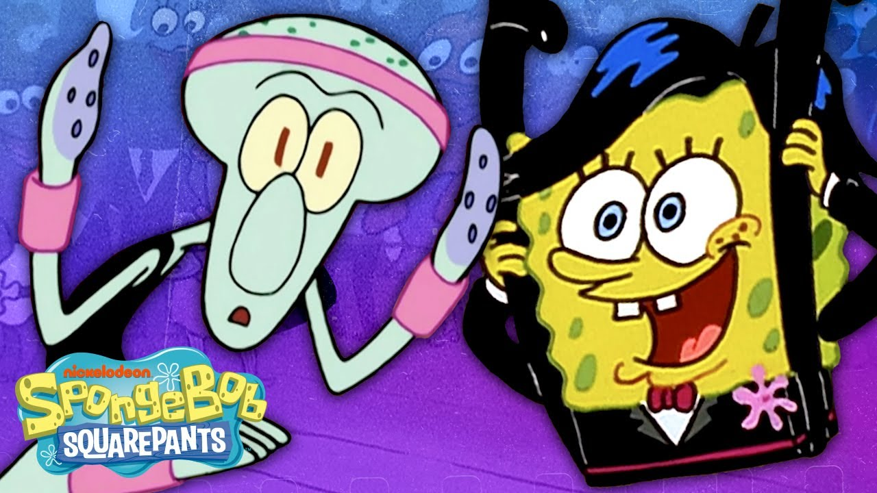
Time to move
Time to move
10 pts
10 pts

Slide 7
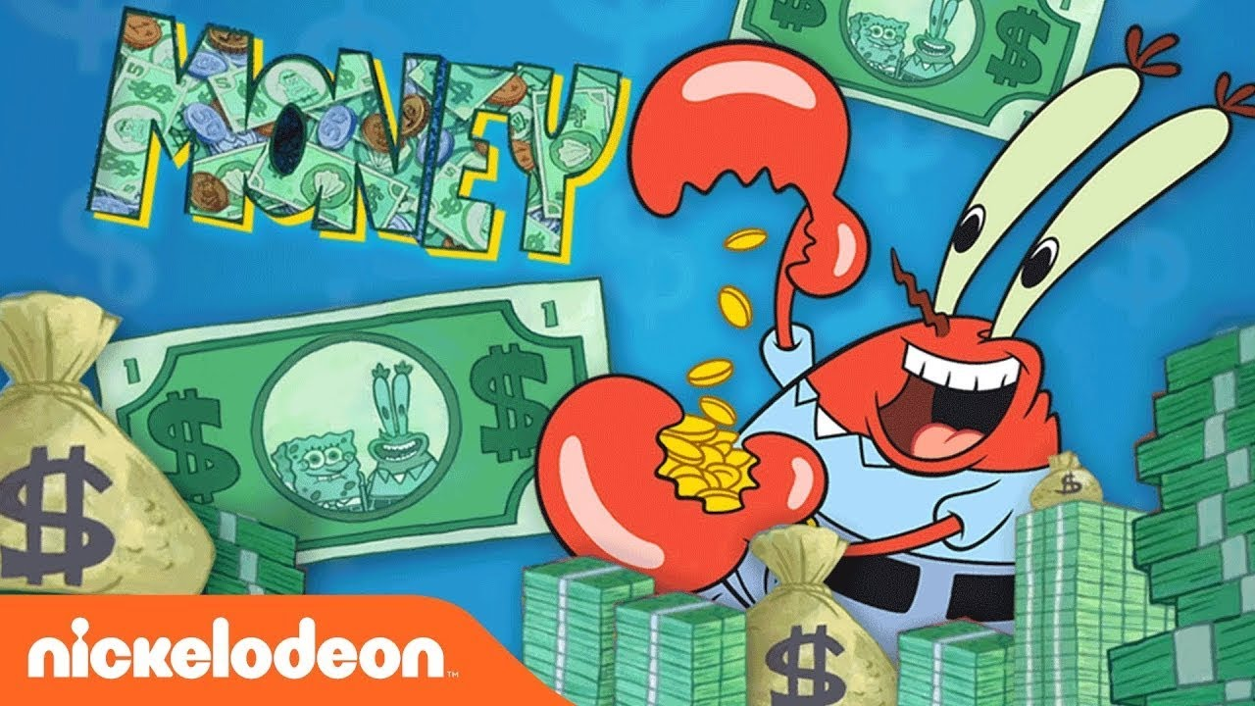
Mr. krabs made money!
Mr. krabs made money
20 pts
20 pts

Slide 8
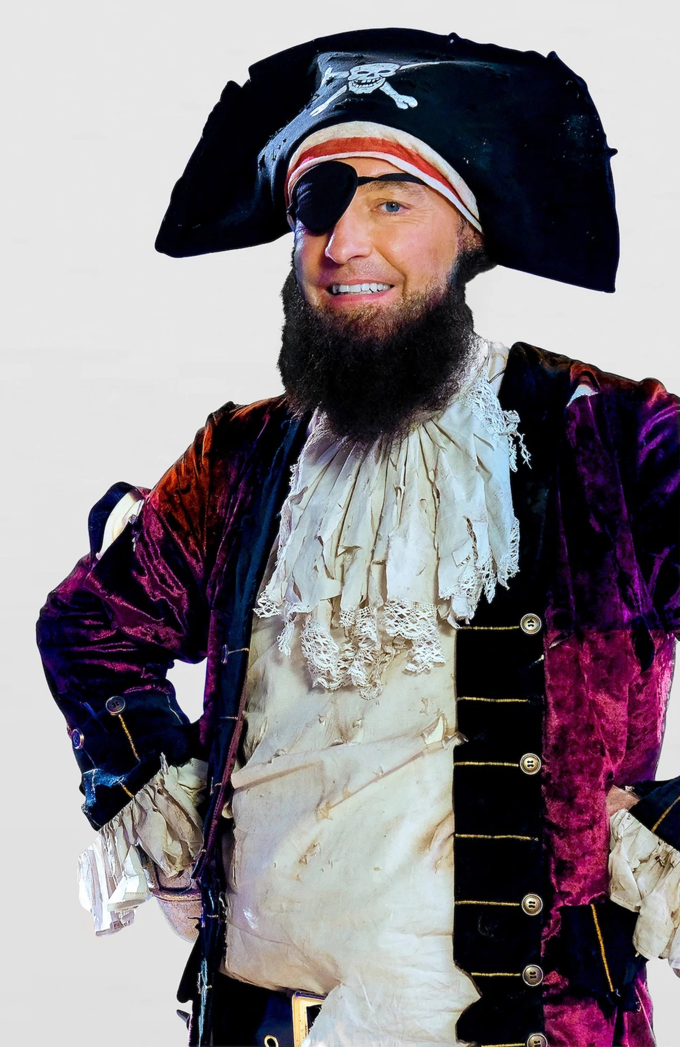
Rock, paper, scissors With another team
Rock, paper, scissors with another team
Winner gets 200 pts
Winner gets 200 pts

