Slide 1



POLICY
DEBATE

Slide 2

  Today, we will look at how to do policy debate
  You will need your brain!
OBJECTIVES

Slide 3



POLICY DEBATE?
WHAT IS
It is a 2-VS-2 plan debate where one team agrees with the resolution and wants to make a policy or law (their plan) and the opposing team disagrees by either saying why their plan is wrong or making an alternate plan.
Before we start, let's go over some terms

Slide 4


HARMS
Harms are the problems in the status quo or emerging problems that will affect the world.
Affirmative will state the problems with the resolution.

Slide 5

HARM EXAMPLE
RESOLUTION: COFFEE SHOULD BE BANNED
The world's addiction to coffee is hurting poor coffee growers and ruining the environment. The WWF reports that rainforest in Central America are being destroyed to make room for coffee plantations. The homes of owl monkeys and other endangered species are in danger because of coffee.

Slide 6
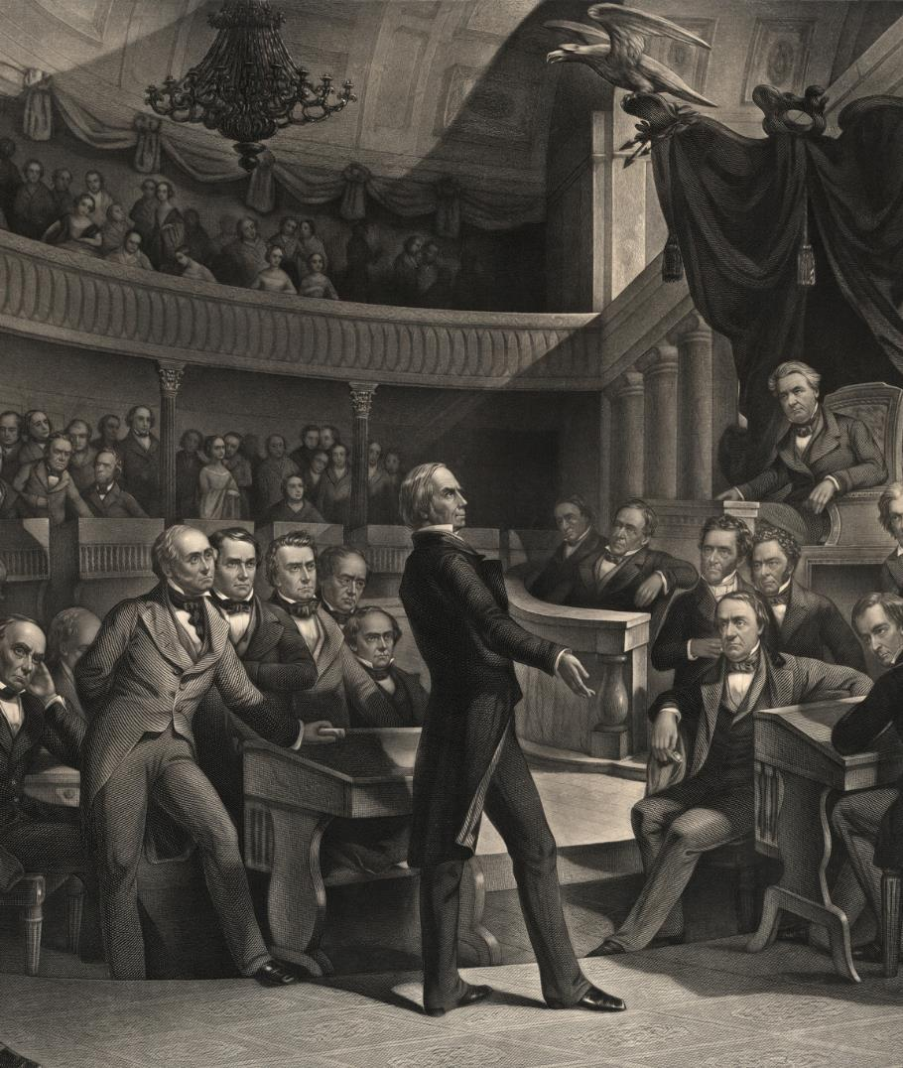
WHAT IS
PLAN
A plan is a policy that the affirmative wants to use to make the resolution happen.
Each plan must consist of 3 things: The actor, the action, and the Enforcement Mechanism and Details

Slide 7
ACTOR
The United Nations
A person that will take the action in the plan
ACTION
Ban the production, sale, and consumption of coffee
The thing the actor will do as part of the plan
ENFORCEMENT MECHANISM AND DETAILS
Any person found growing, selling, or consuming coffee will be arrested and imprison for up to two years
How people will be made to take the action and follow the new policy

Slide 8

COUNTERPLAN EXAMPLE
We, Negative, propose our counterplan. Instead of banning coffee, National Government (Actor) will regulate the industry (Action) by requiring farms to grow their coffee under jungle canopy only (Enforcement Mechanism and Details).

Slide 9




PRO
OPP
1ST Negative
1ST Affirmative
2ND Affirmative
2nd Negative
VS

Slide 10




1ST AFFIRMATIVE CONSTRUCTIVE (1AC)
You are the first speaker in a policy debate. Your job is to establish why the resolution should be upheld. You must state the harms, plans, give 2 arguments, and a solvency.
This speech must be 8 minutes.
SPEECH FORMAT
  Opener
  Roadmap
  Harm
  Plan
  Benefit One
  Benefit Two
  Solvency
  Closer

Slide 11


CROSS EXAMINATION
Question time! 2nd Negative will ask 1st Affirmative a series of questions and 1st Affirmative will have to answer it. It will take 3 minutes.

Slide 12
2ND AFFIRMATIVE REBUTTAL (2AR)
You are the final speaker! Time to win the judges over.
As 2nd Affirmative Rebuttal speaker, your job is to give a final impact to the judge. You must tell the judge all the great, amazing, wonderful things that will happen to the world if your team’s plans are passed.
Then, you must tell the judge all the terrible things that will happen to the world if we listen to Negative’s ideas. Your speech must be 5 minutes.
SPEECH FORMAT
  Opener
  Roadmap
  Final Affirmative Impact
  Final Negative Impact
  Closer

Slide 13

IT’S ALL ABOUT TEAMWORK!
In a debate, you must work with your teammate in order to go far. Listen to them and learn to cooperate. Teamwork makes the dreamwork!

Slide 14

THE MINIMUM WAGE SHOULD BE INCREASED

