Slide 1
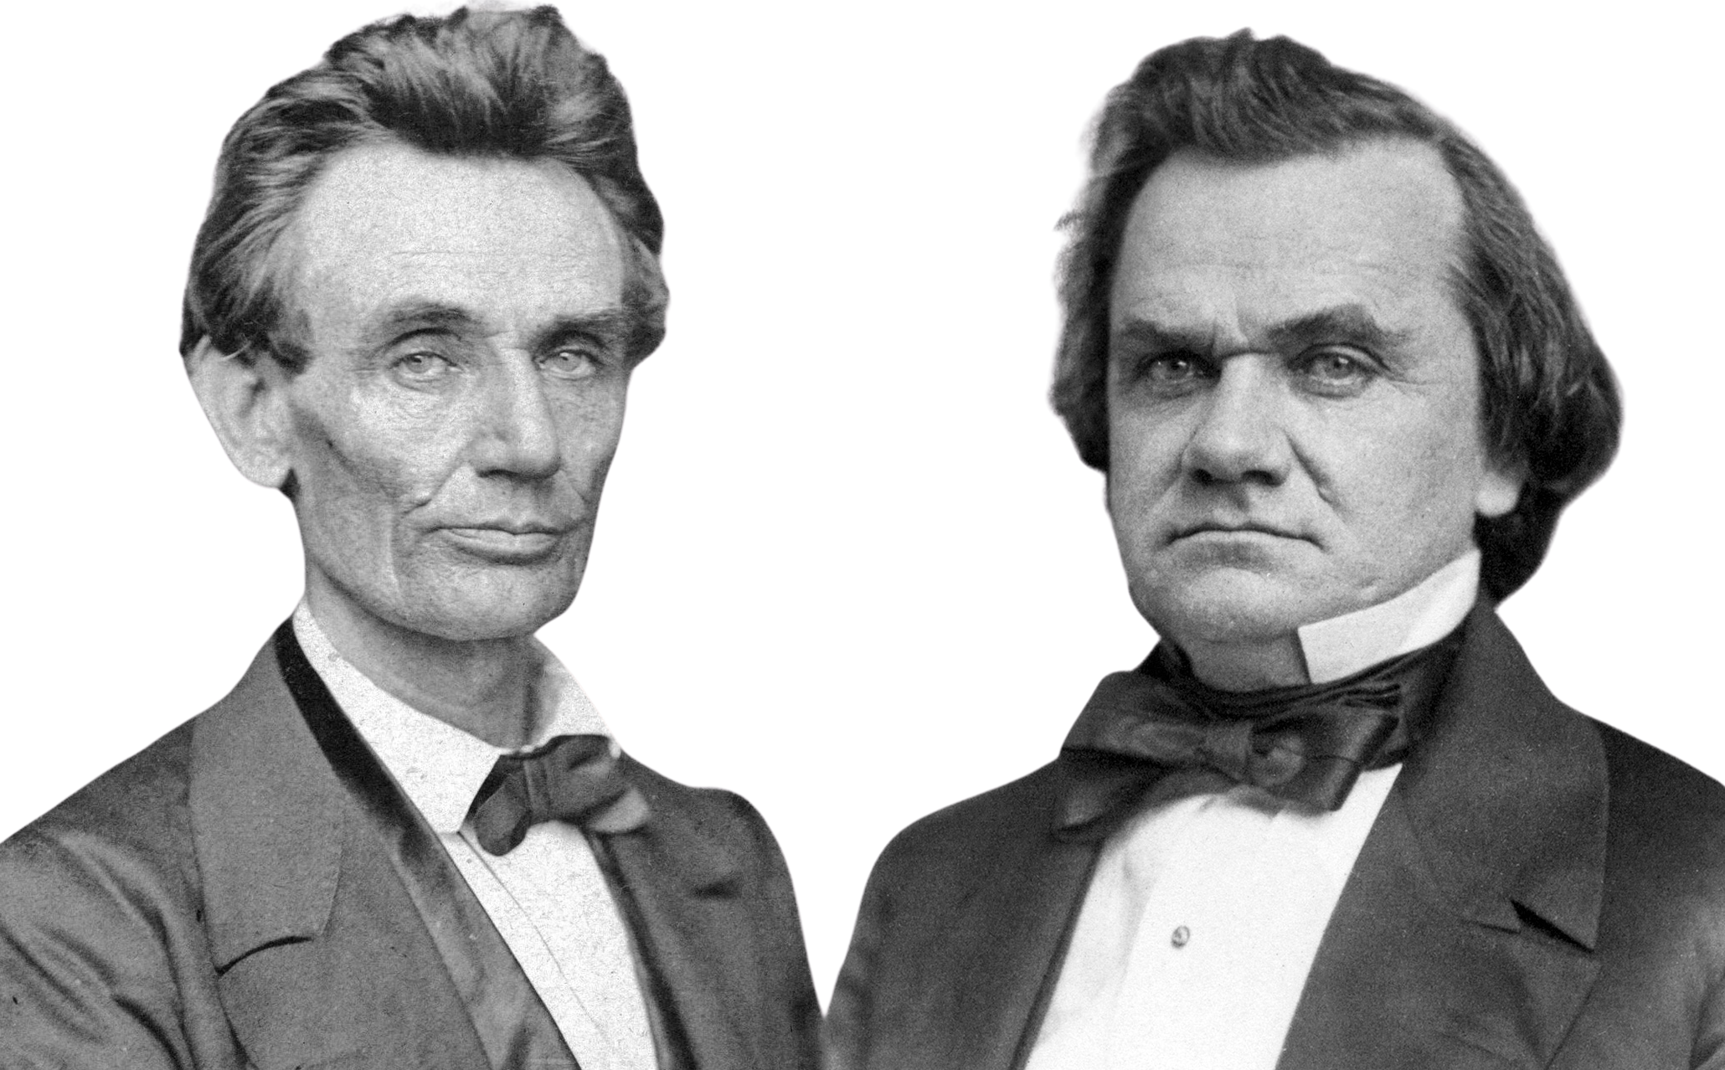


Lincoln Douglas Debate

Slide 2
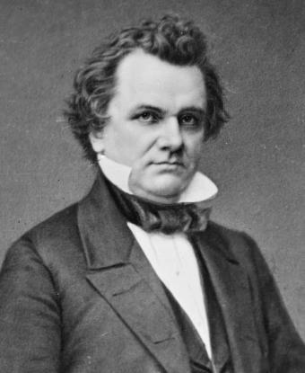


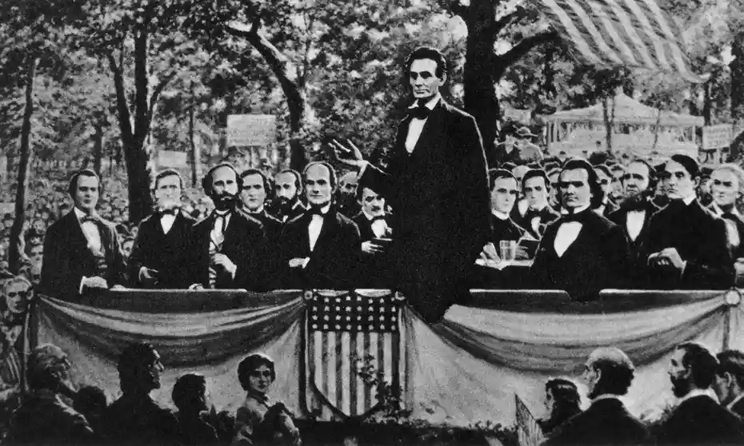

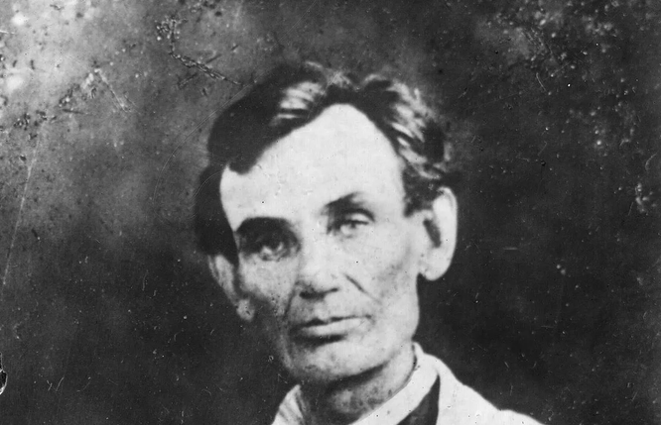
Who are Lincoln and Douglas?
In 1858, there was a Senate Race in Illinois between Abraham Lincoln and Stephen Douglas. At the time, Stephen Douglas was the current senator, but Lincoln wanted to take Douglas’s position. So, Lincoln challenged Douglas to a series of debates. Although the exact format of the debates were slightly different than the Lincoln-Douglas of today, the adversarial nature of the debates was similar.

Slide 3

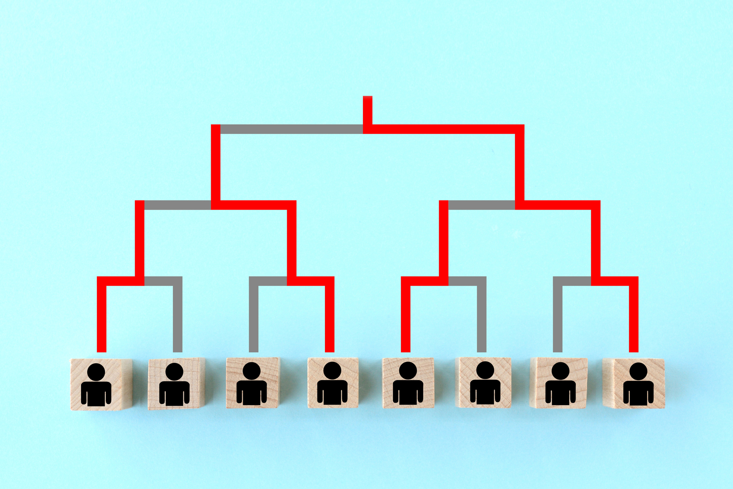
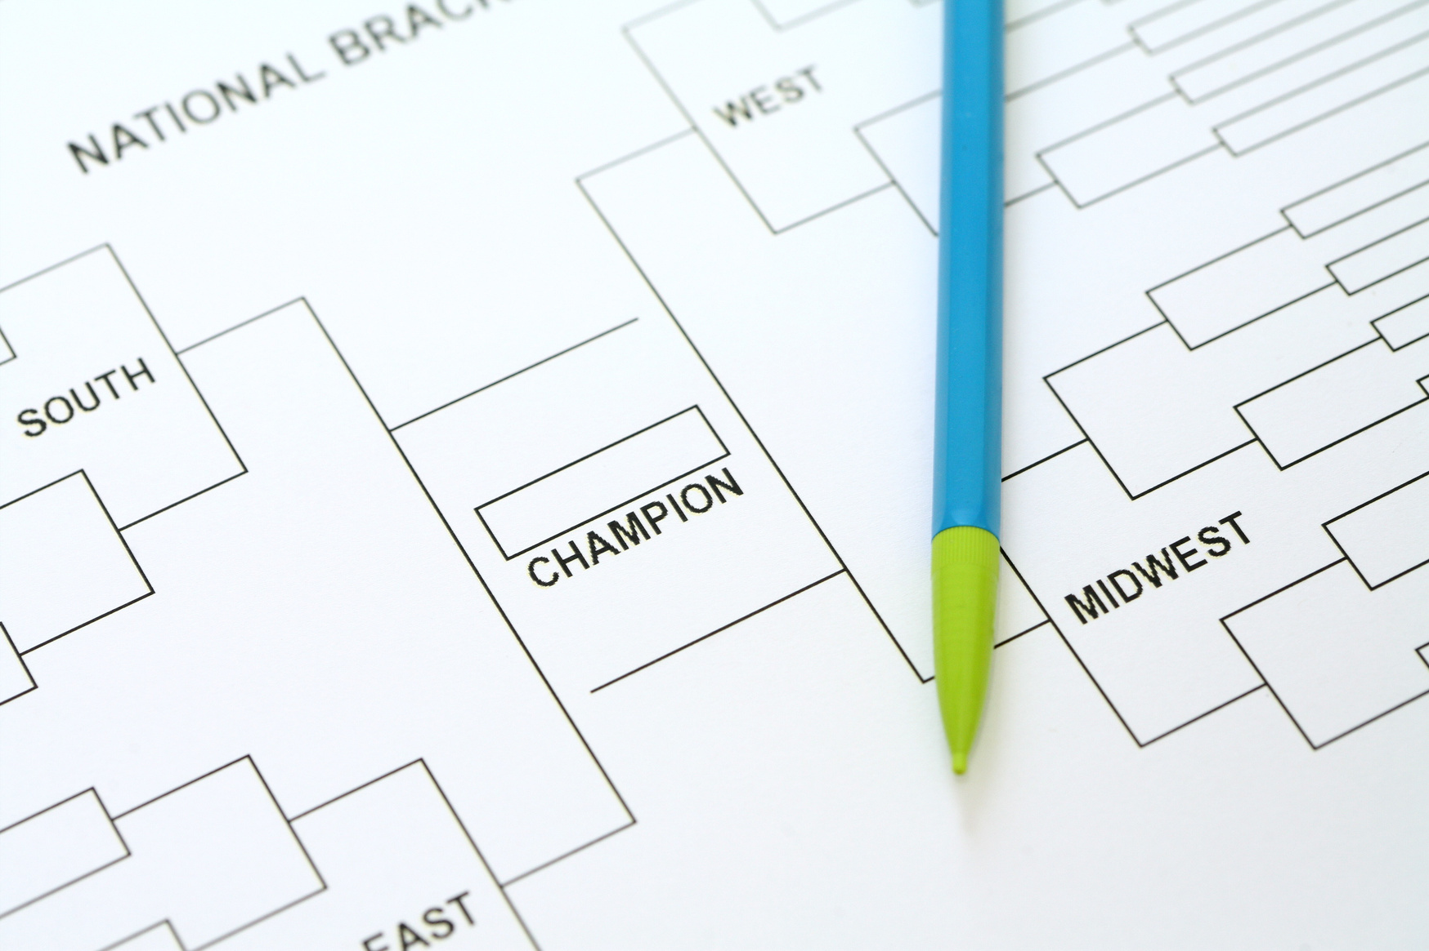


How does LD work?
It is a tournament style. That means that 2 students will debate eachother. After they are done debating, a judge will immediately pick a winner. The winner moves on to the next round.
In each round, you will be assigned a flight (1st or 2nd), a room, an opponent, and a judge.

Slide 4


Words we need to know

Slide 5




There are two sides to each debate
Affirmative
Affirmative debater agrees with the resolution. Their job is to present arguments in order to persuade the judge that the resolution is true.
Negative
The negative debater, on the other hand, disagrees with the resolution and presents arguments to persuade the judge that the resolution is false.

Slide 6
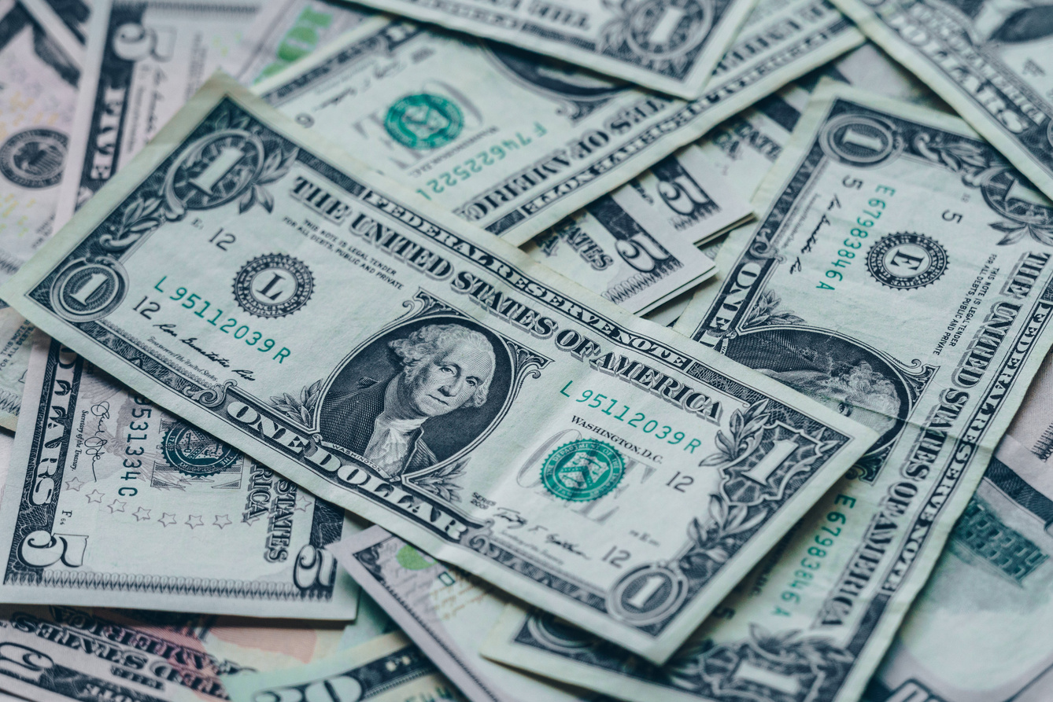





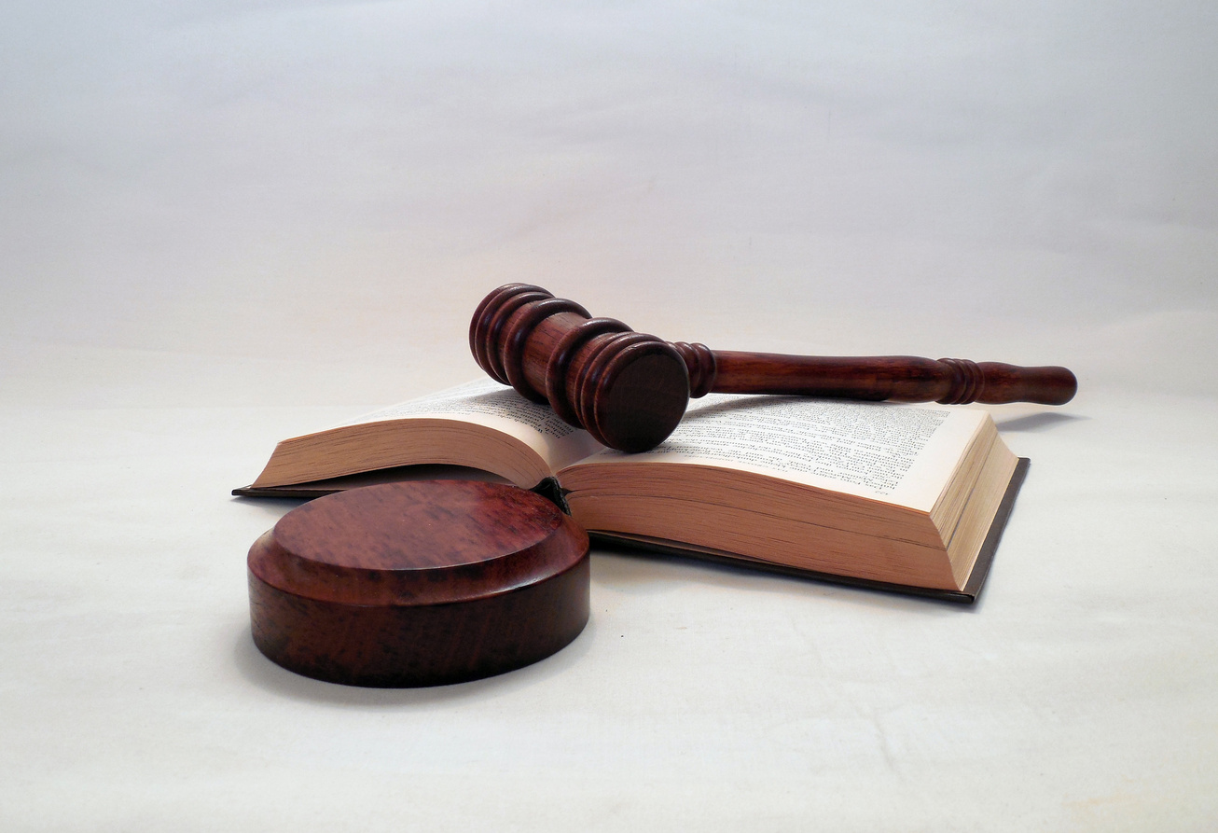



What is a value?
It is what is important to a person or society. Your job in a LD is to explain what your value means and why is it important
For example, the resolution is "people should not smoke." As an affirmative, you think that smoking is dangerous and that your health is really valuable. Your value would be "health." If you are a Negative, you believe that you have the right to do whatever your want to your body and people's rights are more valuable. Then your value will be "human rights."

