Slide 1
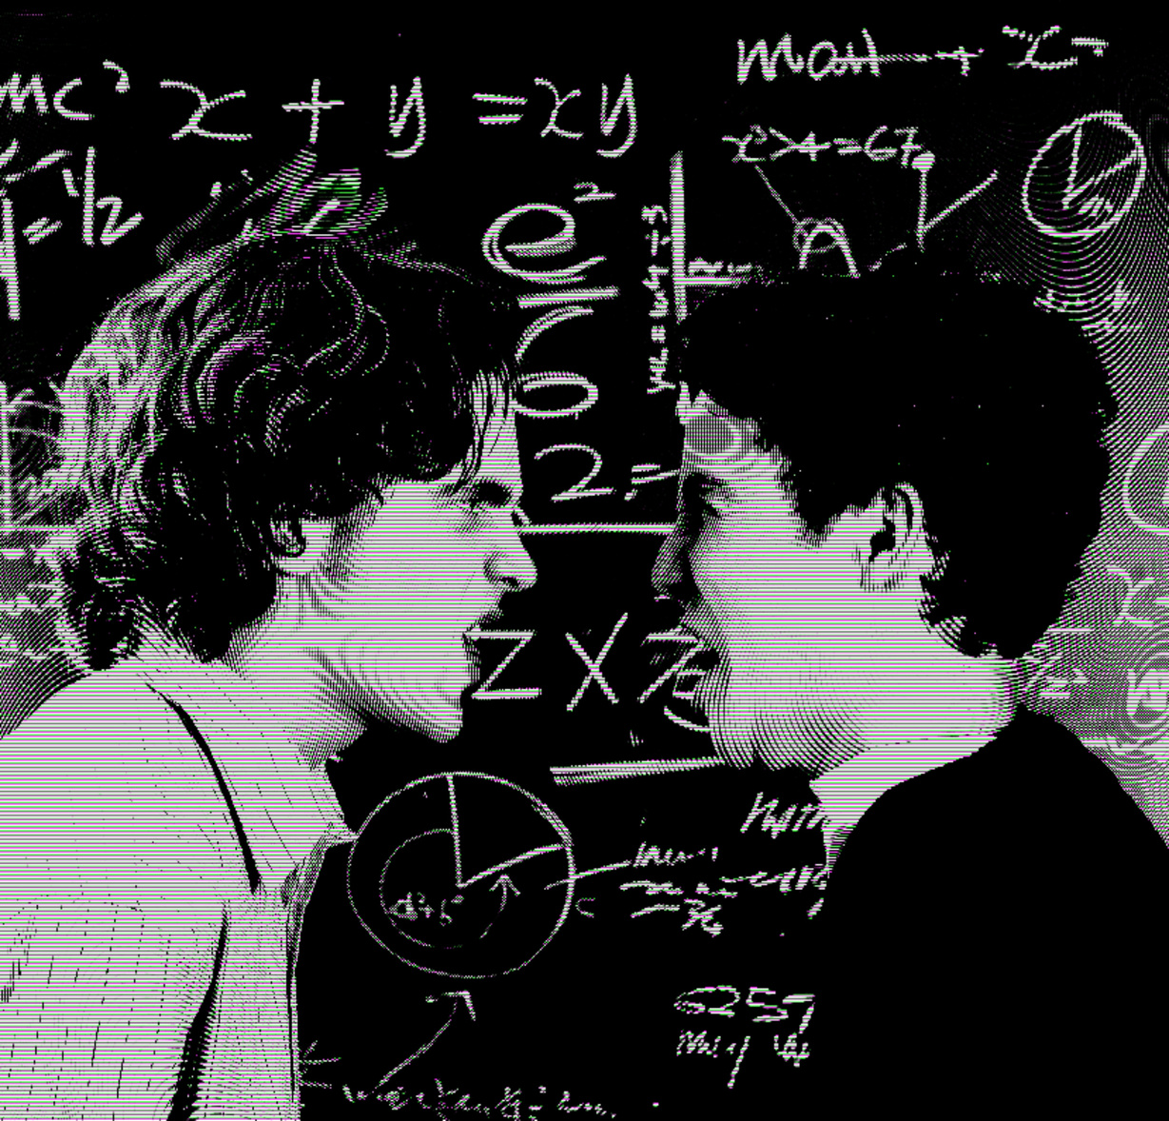



MISS IFE
2020
DEBATE
MPOLY ACADEMY

Slide 2


DEBATE?
WHAT IS
It is a formal argument about a topic.

Slide 3

WHAT IS AN
ARGUMENT?
An argument is a reason that supports an opinion on a topic. It tells people why you agree or disagree with a topic.
Today, we will learn how to make great arguments. Ready?

Slide 4

WHAT IS AN
ASSERTION?
Your assertion is the main idea of the argument. It should be short, only about one sentence.
EXAMPLE
Resolution: Kpop is good for children.
Side: Pro
Assertion: Kpop inspires children

Slide 5


WHAT IS REASONING?
It is very important that you explain your assertion. Reasoning is the details that explain your assertion.

Slide 6

WHAT IS
EVIDENCE?
Evidence is any information that proves your argument. When you add evidence, it makes your argument better and stronger.

Slide 7

Evidence: My favorite Idol, Jennie from BlackPink has listened to only KPop since she was 10 years old, and it inspired her to learn how to sing and dance and now she is one of the most famous Idols in the world!

Slide 8
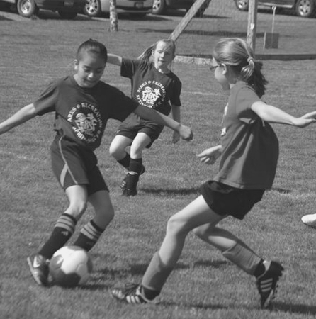
WHAT IS A
REFUTATION?
A refutation is when you attack the other team's argument. You do this by telling the other team why their assertion, reasoning, evidence, or impact is wrong.
Resolution: Soccer is beneficial for kids.

Slide 9
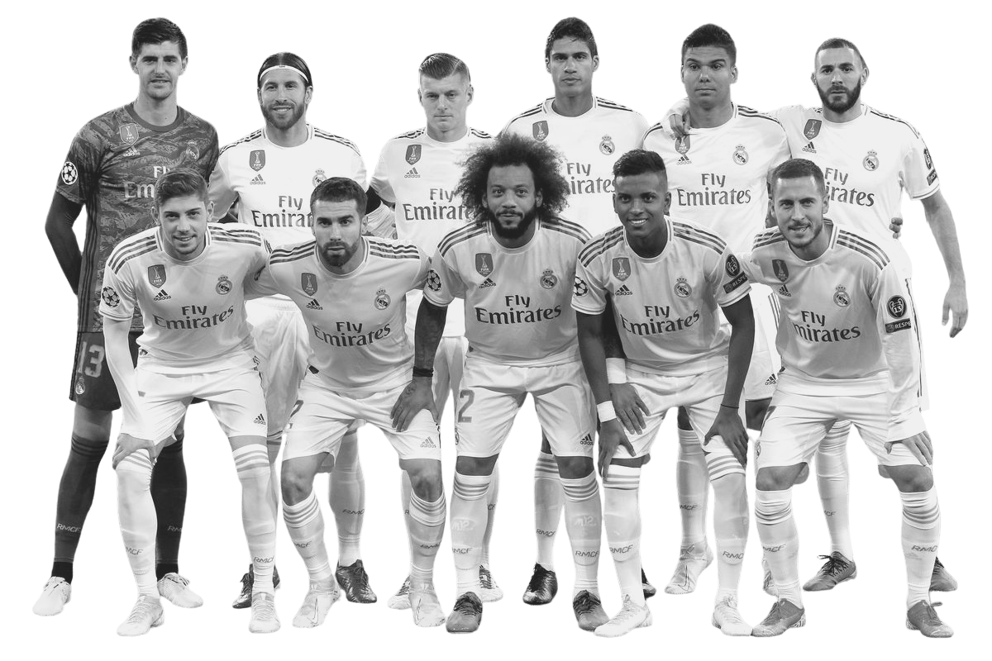
Resolution: Soccer is beneficial for kids.
Their first argument was soccer does not teach important skills. But we disagree. We believe that kids learn lots of useful skills in soccer. This is because soccer encourages teamwork. In soccer, kids learn to work as a team to achieve a goal. In order to do this, they must collaborate, communicate, and cooperate together. Learning teamwork now will help them later in life.

Slide 10

WHAT IS THE
THIRD SPEAKER'S ROLE?
It is the third speaker's job to tell the judge whom to vote for and why. To do this, the third speaker needs to compare the Pro and Con's idea and tell the judge why your team's arguments are better and why your team should win the debate.
TO DO THIS, YOU WILL USE THEIR WORLD-OUR WORLD

