Slide 1


GRAVITY IS A FORCE EXERTED BY MASSES
P77-83C

Slide 2


OBJECTIVES
  To describe how mass and distance affect gravity
2. To explain what keeps objects in orbit

Slide 3
WARM-UP
Why do you think astronauts in space float?

Slide 4

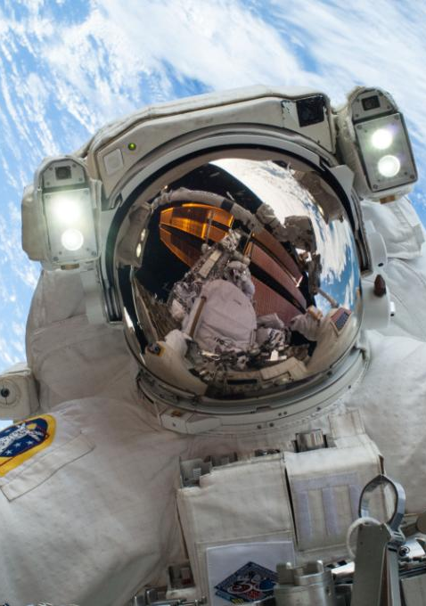
VOCABULARY
GRAVITY
the force that objects exert on each other because of their masses
WEIGHT
the force of gravity on an object
ORBIT
the elliptical (circular) path one body follows around another body due to the influence of gravity

Slide 5


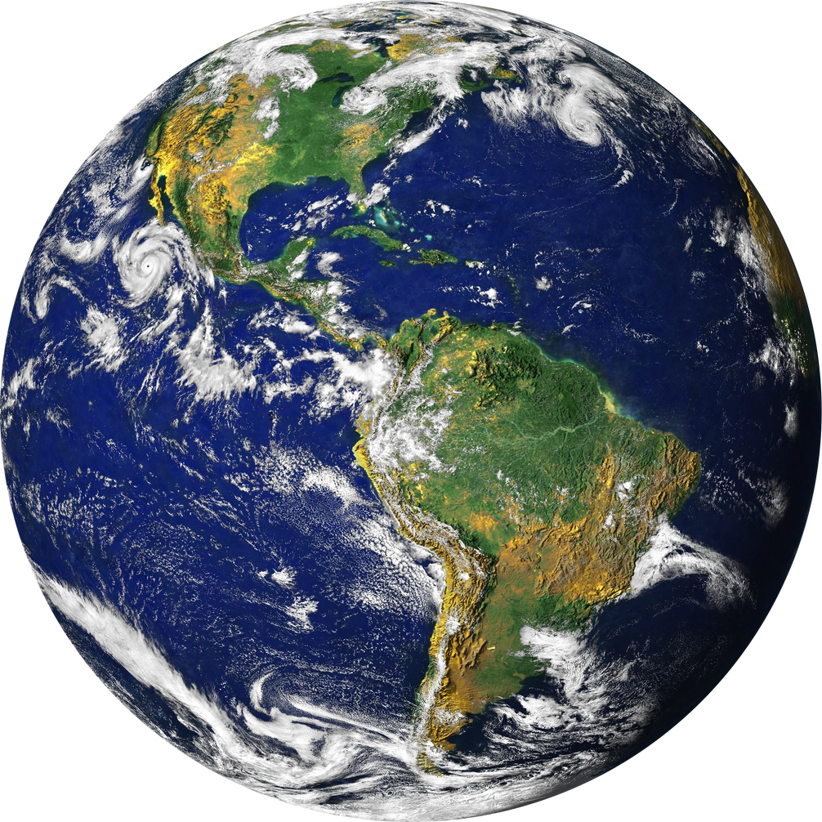
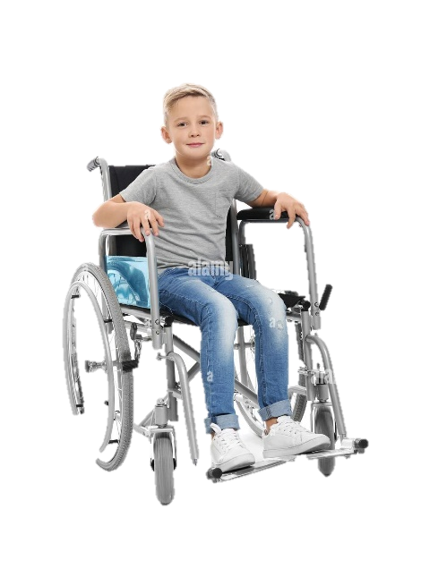
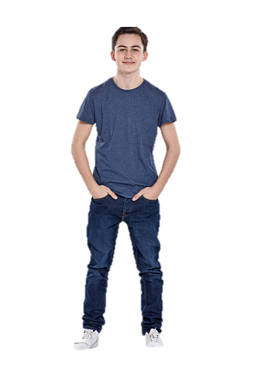
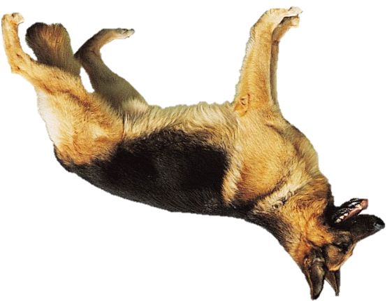

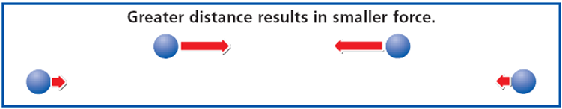
MASSES ATTRACT EACH OTHER
•Gravity acts between any two masses anywhere in the universe
• The strength of gravitational force depends on mass and distance
Greater mass = greater gravitational force
• Greater distance = smaller gravitational force

Slide 6
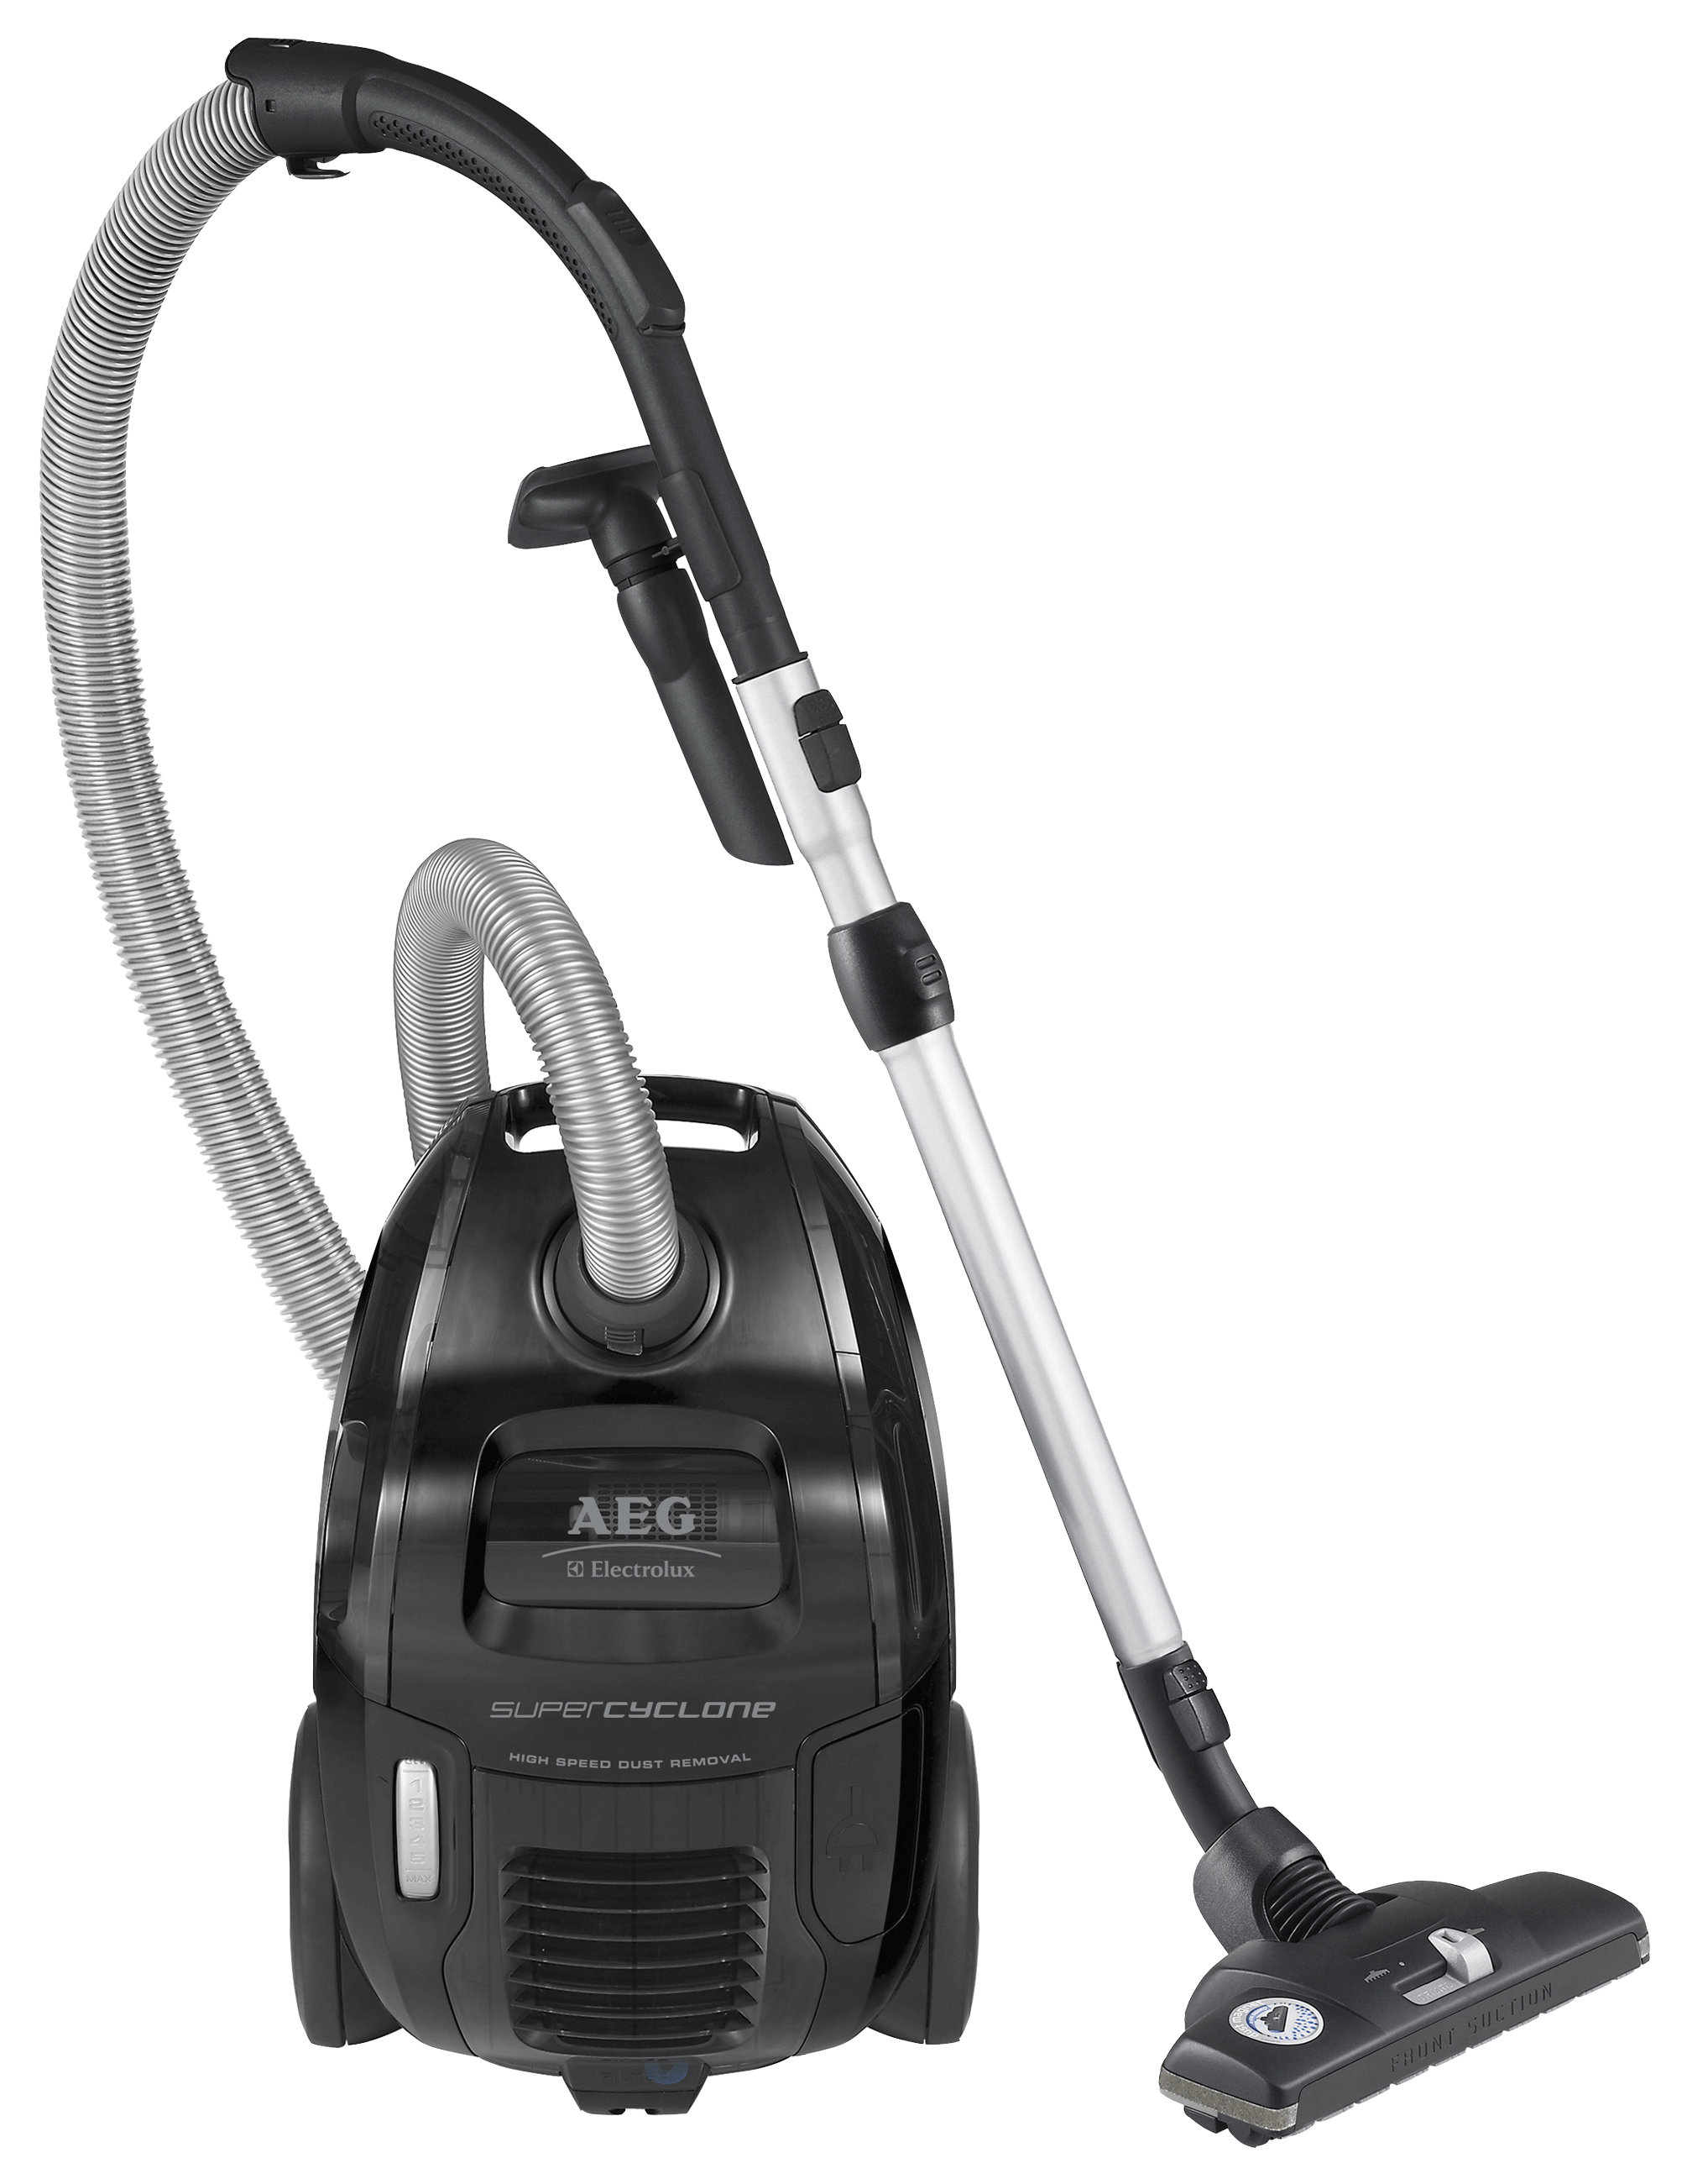

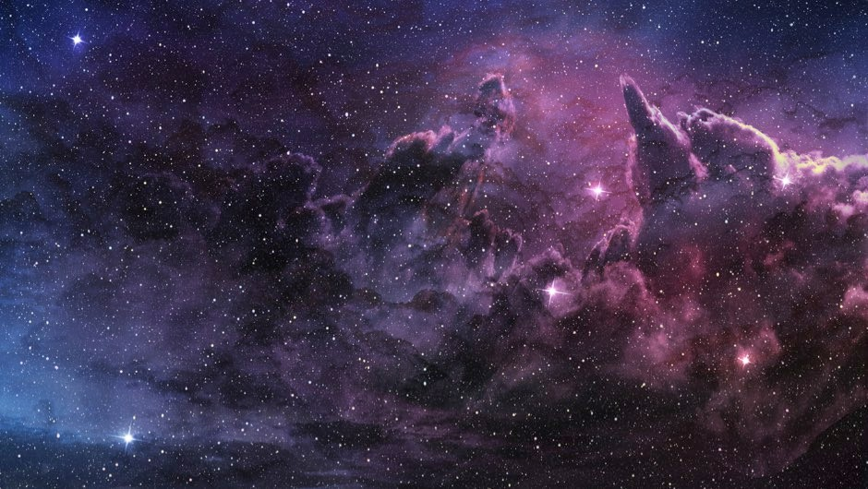
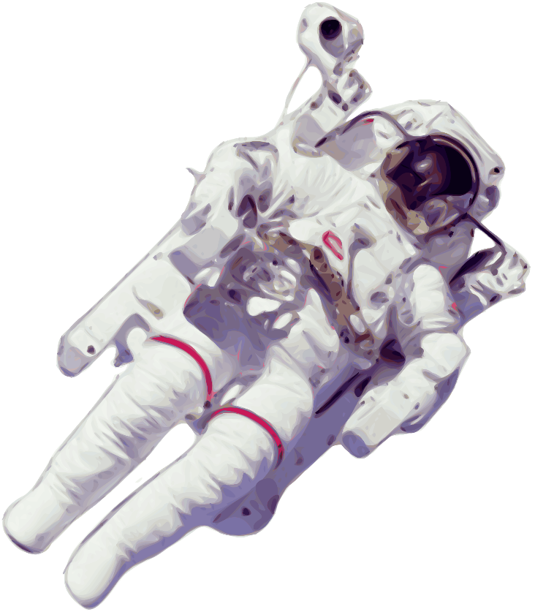

MASSES ATTRACT EACH OTHER
• Acceleration due to Earth’s gravity is g
g = 9.8 m/s²
• F = mg is used to calculate the force due to gravity on a mass close to Earth’s surface
•All falling objects have the same rate of acceleration in a vacuum
*A vacuum is a place or space with no matter or air
• Horizontal velocity does not affect acceleration due to gravity

Slide 7

0 s
Horizontal velocity does not affect acceleration due to gravity
Because of gravity, objects will fall at the same rate, regardless of their initial direction.
1 s
4 s

Slide 8
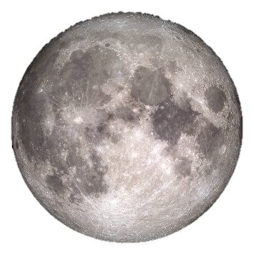
Because the moon is smaller than the Earth, there is less gravity. That means that there is less weight on the moon

Slide 9

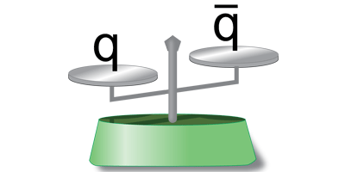
MASSES ATTRACT EACH OTHER
  Weight and mass are related but different
  Weight = force of gravity on an object
  Mass = how much matter an object contains)
    E.g. A 50 kg person has that same mass no matter where they are
    We use a balance to measure the mass of an object
    However, their weight might change. If they go to the moon, their weight is less than it is on Earth
On Earth
Mass = 50 kg
Weight = 490 N
On the Moon
Mass = 50 kg
Weight = 82 N

Slide 10
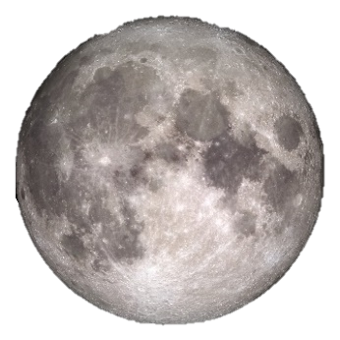
GRAVITY KEEPS OBJECTS IN ORBIT
•Newton hypothesized that the force that pulls objects to the ground also pulls the Moon in its orbit around Earth
•Centripetal force keeps one object in orbit around another

Slide 11
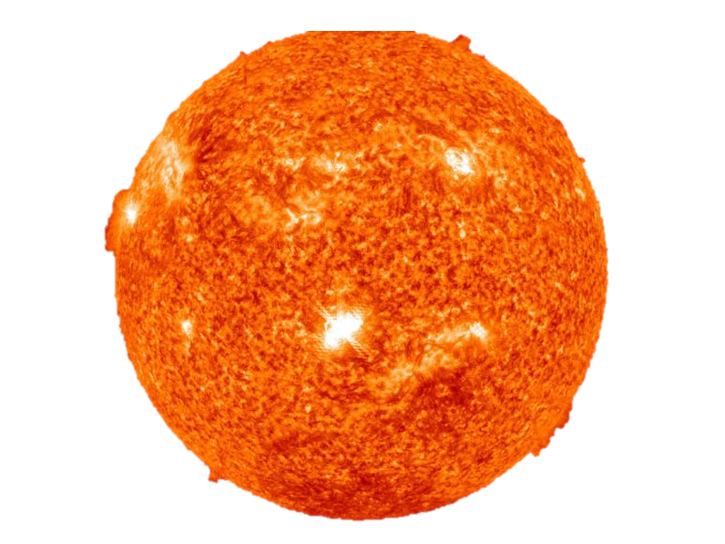
Earth is pulled around the Sun by the gravitational force between Earth and the Sun
If an object traveled long and fast enough along Earth’s surface, it would eventually go into orbit

Slide 12
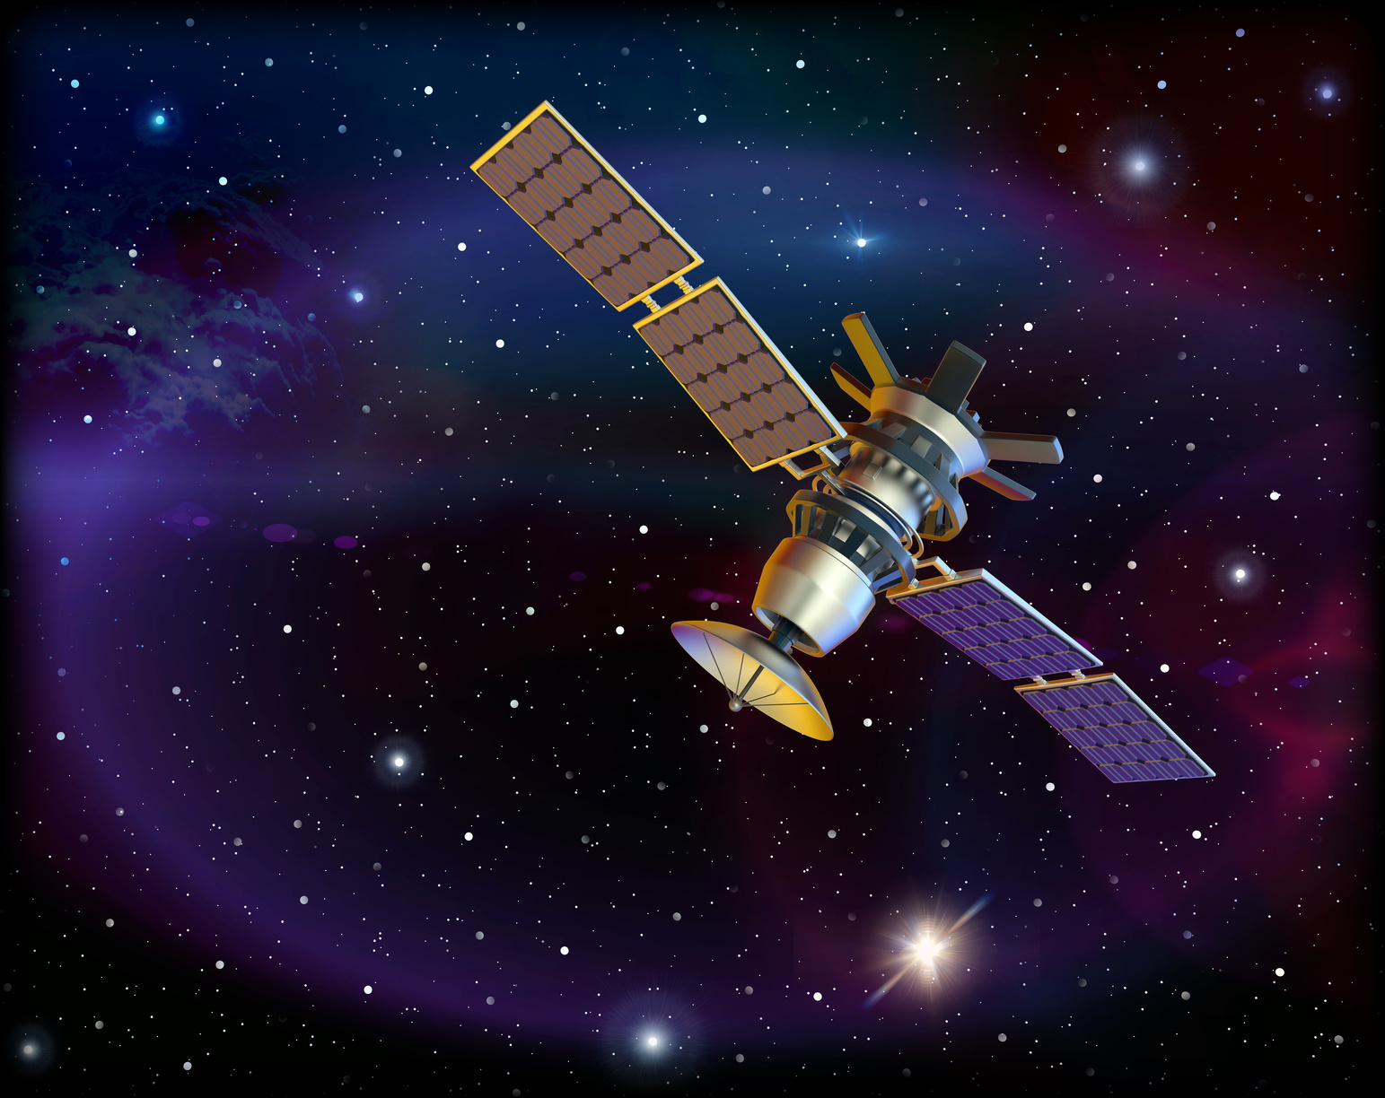
GRAVITY KEEPS OBJECTS IN ORBIT
The every 8000 meters, the earth curves about 5 meters downward
    The minimum speed needed to send an object into orbit is approximately 8000 meters per second
    any object in space is falling back to earth. The only way to keep them in space is if it moves really fast along the earth’s curve.
    If it’s too slow, it will fall back to earth.
  Escape velocity –. It the speed in which an object reaches that releases it from the gravitational pull of another object

Slide 13

GRAVITY KEEPS OBJECTS IN ORBIT
•A spacecraft in orbit is in free fall
  Free falling is when an object fall under gravity only
• Astronauts in space, the spacecraft and their bodies are falling around Earth at the same rate. Because of that, they are always floating around
• The weight of the astronauts does not press against the floor, so they appear weightless

Slide 14
  QUIZ TIME

Slide 15

Answer: Gravity is present everywhere in the universe. (p77C)
WHY IS GRAVITY CONSIDERED A UNIVERSAL FORCE?

Slide 16
Answer: As mass increases, gravity increases. As distance increases, gravity decreases. (p78C)
HOW DO MASS AND DISTANCE AFFECT THE FORCE OF GRAVITY?

Slide 17
Answer: 4,498.2 N
What is the force will an elephant that weights 459kg make after falling from a 900 meter building?

Slide 18
Answer: It is also doubled. (p78C)
TWO OBJECTS ARE EXERTING FORCE ON EACH OTHER.
If one of the masses is doubled, what happens to the force of gravity between the objects?

Slide 19
Answer: Those standing one meter apart. (p78C)
WHICH HAS MORE GRAVITATIONAL ATTRACTION, A PAIR OF STUDENTS STANDING ONE METER APART OR THE SAME STUDENTS STANDING THREE METERS APART?

Slide 20
Answer: Mass (p79C)
WHAT WORD DESCRIBES THE AMOUNT OF MATTER AN OBJECT CONTAINS?

Slide 21
Answer: They fall in the same time if they are in a vacuum. (p79C)
COMPARE THE TIMES IT TAKES TWO OBJECTS WITH DIFFERENT MASSES TO FALL FROM THE SAME HEIGHT.

Slide 22
Answer: The gravitational attraction of Earth and centripetal force (p80C)
WHAT KEEPS THE MOON IN ORBIT?

Slide 23
Answer: its speed and gravity (p80C)
WHAT TWO FACTORS KEEP AN OBJECT IN ORBIT?

Slide 24
Answer: It escapes Earth’s gravity. (p82C)
WHAT HAPPENS WHEN A SPACECRAFT IS LAUNCHED AT TOO GREAT A SPEED?

Slide 25
Answer: The astronauts and the spaceship are falling at the same rate. They are in free fall. (p83C)
WHY DO ASTRONAUTS FLOAT WHEN THEY ARE IN ORBIT?

Slide 26

Wrap Up
WHY WOULD YOU WEIGH DIFFERENTLY ON THE MOON THAN YOU WOULD ON EARTH?

Slide 27

HOMEWORK
EPOLY
CORNELL NOTES

Slide 28


THANK YOU
I HOPE YOU LEARNED SOMETHING NEW!

